Slide 1








Transfer Learning in
Natural Language Processing
June 2, 2019
NAACL-HLT 2019
Sebastian Ruder
Matthew Peters
Swabha
Swayamdipta
Thomas Wolf

Slide 2
Transfer Learning in Natural Language Processing
Transfer Learning in NLP
Follow along with the tutorial:
Slides: http://tiny.cc/NAACLTransfer
Colab: http://tiny.cc/NAACLTransferColab
Code: http://tiny.cc/NAACLTransferCode
Questions:
Twitter: #NAACLTransfer during the tutorial
Whova: “Questions for the tutorial on Transfer Learning in NLP” topic
Ask us during the break or after the tutorial

Slide 3
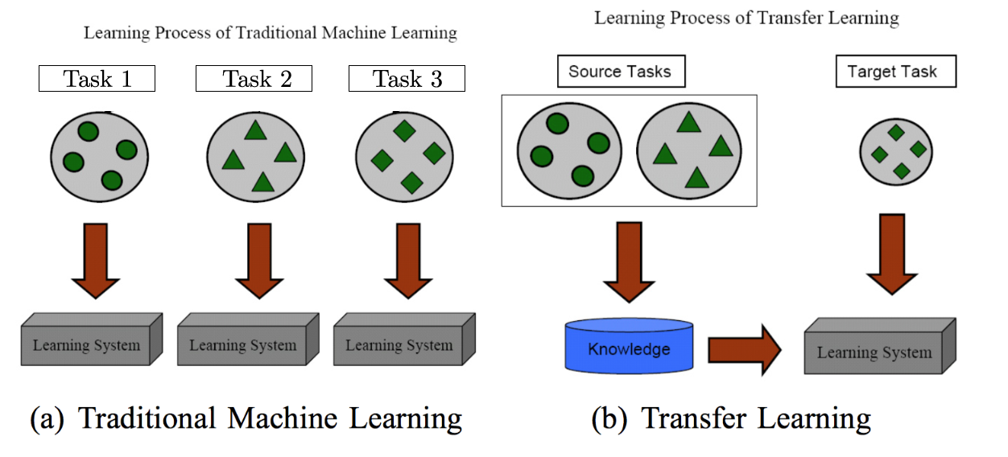
What is transfer learning?
Pan and Yang (2010)

Slide 4
Why transfer learning in NLP?
Many NLP tasks share common knowledge about language (e.g. linguistic representations, structural similarities)
Tasks can inform each other—e.g. syntax and semantics
Annotated data is rare, make use of as much supervision as available.
Empirically, transfer learning has resulted in SOTA for many supervised NLP tasks (e.g. classification, information extraction, Q&A, etc).

Slide 5
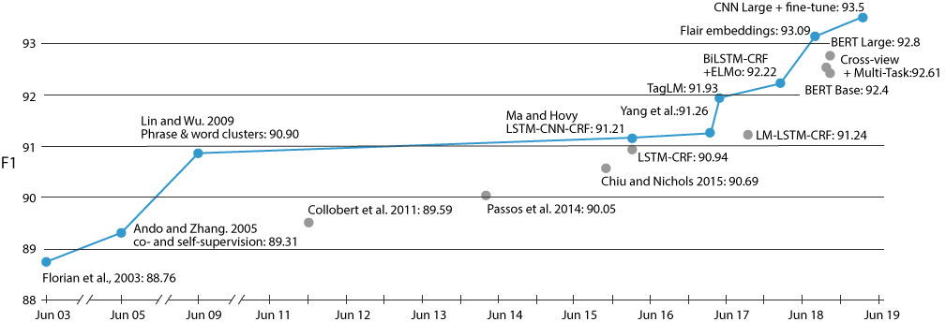
Why transfer learning in NLP? (Empirically)
Performance on Named Entity Recognition (NER) on CoNLL-2003 (English) over time

Slide 6
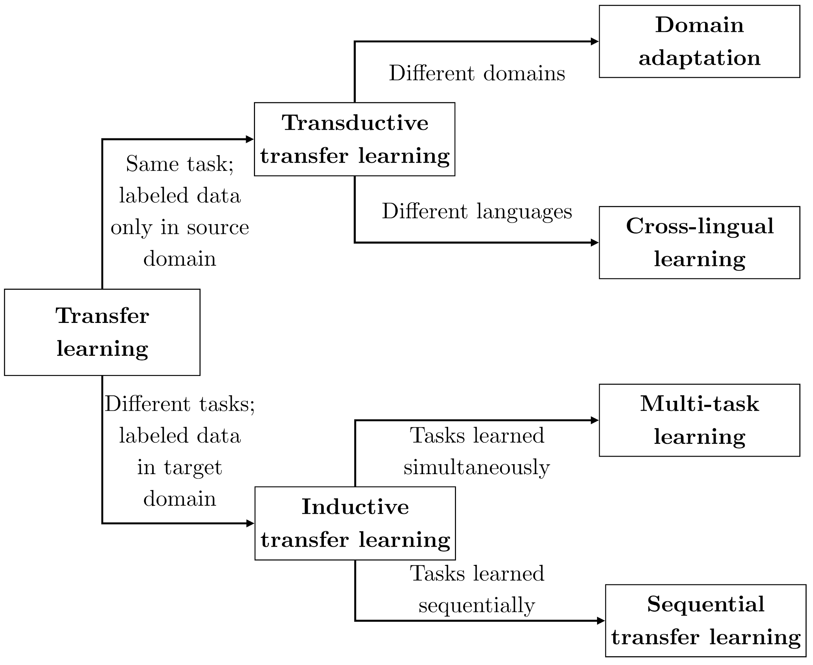
Types of transfer learning in NLP
We will focus on this
Ruder (2019)

Slide 7
What this tutorial is about and what it’s not about
Goal: provide broad overview of transfer methods in NLP, focusing on the most empirically successful methods as of today (mid 2019)
Provide practical, hands on advice → by end of tutorial, everyone has ability to apply recent advances to text classification task
What this is not: Comprehensive (it’s impossible to cover all related papers in one tutorial!)
(Bender Rule: This tutorial is mostly for work done in English, extensibility to other languages depends on availability of supervision.)

Slide 8






Agenda
[1] Introduction
[2] Pretraining
[4] Adaptation
[5] Downstream
[3] What’s in a representation?
[6]
Open Problems
Notes:
Introduction (15 mins)
Pretraining (40 mins)
Hands-on code (15 mins)
Break (15 mins)
What do the representations capture (30 mins)
Adaptation (40 mins)
Downstream applications (20 mins)
Open problems and directions (20 mins)

Slide 9
Introduction

Slide 10


Sequential transfer learning
Learn on one task / dataset, then transfer to another task / dataset
word2vec
GloVe
skip-thought
InferSent
ELMo
ULMFiT
GPT
BERT
Pretraining
Adaptation
classification
sequence labeling
Q&A
....

Slide 11
Pretraining tasks and datasets
Unlabeled data and self-supervision
Supervised pretraining
Easy to gather very large corpora: Wikipedia, news, web crawl, social media, etc.
Training takes advantage of distributional hypothesis: “You shall know a word by the company it keeps” (Firth, 1957), often formalized as training some variant of language model
Focus on efficient algorithms to make use of plentiful data
Very common in vision, less in NLP due to lack of large supervised datasets
Machine translation
NLI for sentence representations
Task-specific—transfer from one Q&A dataset to another

Slide 12
Target tasks and datasets
Target tasks are typically supervised and span a range of common NLP tasks:
Sentence or document classification (e.g. sentiment)
Sentence pair classification (e.g. NLI, paraphrase)
Word level (e.g. sequence labeling, extractive Q&A)
Structured prediction (e.g. parsing)
Generation (e.g. dialogue, summarization)

Slide 13
Concrete example—word vectors
Word embedding methods (e.g. word2vec) learn one vector per word:
cat = [0.1, -0.2, 0.4, …]
dog = [0.2, -0.1, 0.7, …]

Slide 14
Concrete example—word vectors
Word embedding methods (e.g. word2vec) learn one vector per word:
PRP VBP PRP NN CC NN .
I love my cat and dog .
cat = [0.1, -0.2, 0.4, …]
dog = [0.2, -0.1, 0.7, …]

Slide 15
Concrete example—word vectors
Word embedding methods (e.g. word2vec) learn one vector per word:
PRP VBP PRP NN CC NN .
I love my cat and dog .
cat = [0.1, -0.2, 0.4, …]
dog = [0.2, -0.1, 0.7, …]
I love my cat and dog . }-> “positive"

Slide 16
Major Themes

Slide 17
Major themes: From words to words-in-context
Word vectors
Sentence / doc vectors
Word-in-context vectors
cats = [0.2, -0.3, …]
dogs = [0.4, -0.5, …]
We have two cats.
}
[-1.2, 0.0, …]
[1.2, -0.3, …]
}
We have two cats.
It’s raining cats and dogs.
}
[-0.4, 0.9, …]
[0.8, 0.9, …]
}
It’s raining cats and dogs.

Slide 18
Major themes: LM pretraining
Many successful pretraining approaches are based on language modeling
Informally, a LM learns P_{ϴ}(text) or P_{ϴ}(text | some other text)
Doesn’t require human annotation
Many languages have enough text to learn high capacity model
Versatile—can learn both sentence and word representations with a variety of objective functions

Slide 19
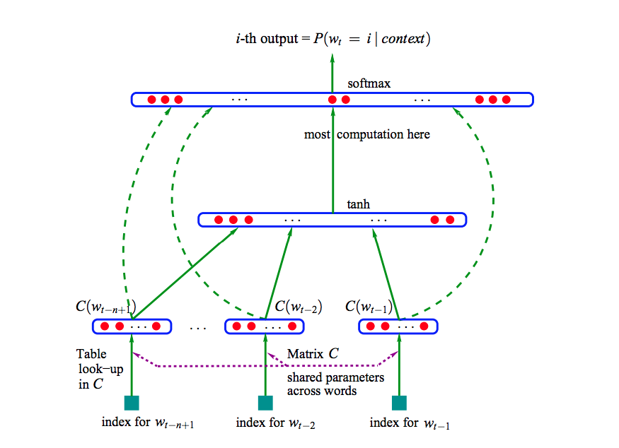
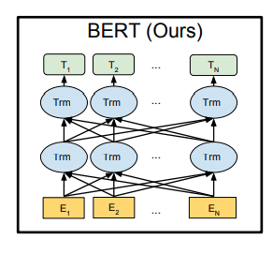
1 layer
Bengio et al 2003: A Neural Probabilistic Language Model
Devlin et al 2019: BERT: Pre-training of Deep Bidirectional Transformers for Language Understanding
Major themes: From shallow to deep
24 layers

Slide 20
Major themes: pretraining vs target task
Choice of pretraining and target tasks are coupled
Sentence / document representations not useful for word level predictions
Word vectors can be pooled across contexts, but often outperformed by other methods
In contextual word vectors, bidirectional context important
In general:
Similar pretraining and target tasks → best results

Slide 21
Agenda
[1] Introduction
[2] Pretraining
[4] Adaptation
[5] Downstream
[3] What’s in a representation?
[6]
Open Problems

Slide 22
2. Pretraining
Image credit: Creative Stall

Slide 23
Overview
Language model pretraining
Word vectors
Sentence and document vectors
Contextual word vectors
Interesting properties of pretraining
Cross-lingual pretraining

Slide 24

Word Type Representation
We [have a ??? and three] dogs
We have a ???
We like pets. }
We have a ???
We have a MASK and three dogs
LM pretraining
word2vec, Mikolov et al (2013)
ELMo, Peters et al. 2018, ULMFiT (Howard & Ruder 2018), GPT (Radford et al. 2018)
BERT, Devlin et al 2019
???
Skip-Thought (Kiros et al., 2015)

Slide 25
Word vectors

Slide 26
Why embed words?
Embeddings are themselves parameters—can be learned
Sharing representations across tasks
Lower dimensional space
Better for computation—difficult to handle sparse vectors.

Slide 27
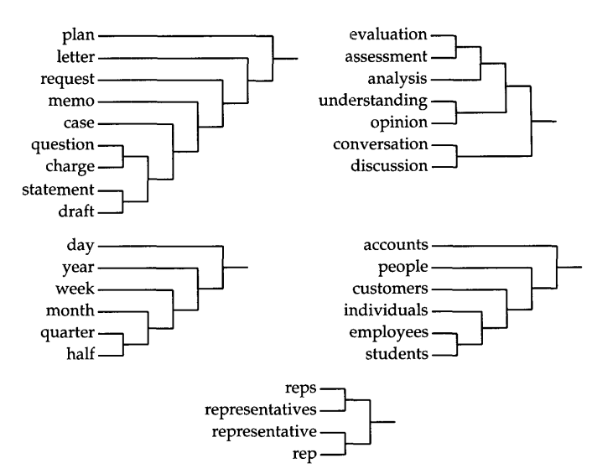
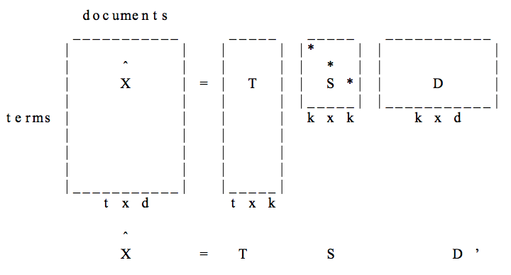
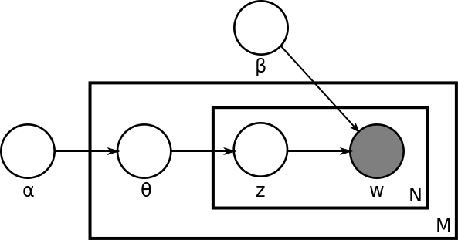
Word Type Representation
Unsupervised pretraining : Pre-Neural
Latent Semantic Analysis (LSA)—SVD of term-document matrix, (Deerwester et al., 1990)
Brown clusters, hard hierarchical clustering based on n-gram LMs, (Brown et al. 1992)
Latent Dirichlet Allocation (LDA)—Documents are mixtures of topics and topics are mixtures of words (Blei et al., 2003)

Slide 28
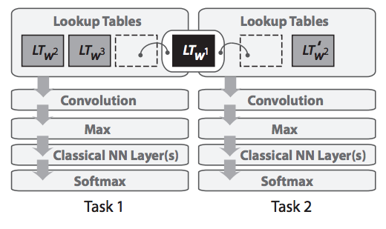
Word Type Representation
n-gram neural language model (Bengio et al. 2003)
Supervised multitask word embeddings (Collobert and Weston, 2008)
Word vector pretraining

Slide 29
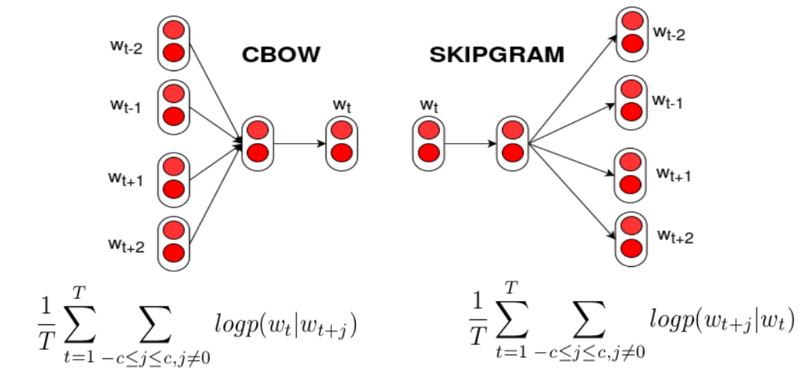
See also:
Pennington et al. (2014): GloVe
Bojanowski et al. (2017): fastText
word2vec
Efficient algorithm + large scale training → high quality word vectors
(Mikolov et al., 2013)

Slide 30
Sentence and document vectors

Slide 31
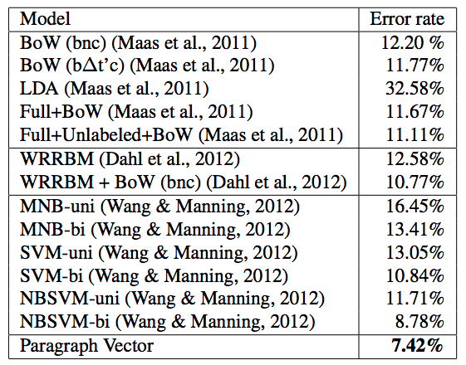
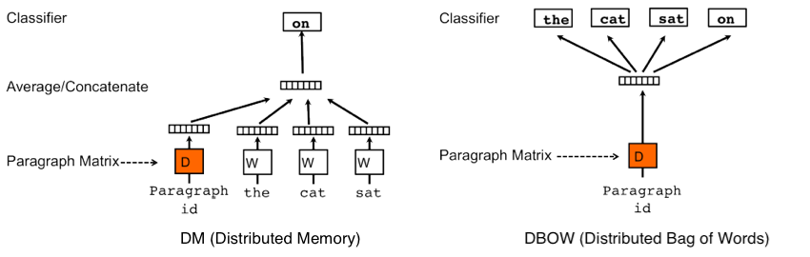
Doc2vec
Paragraph vector
Unsupervised paragraph embeddings (Le & Mikolov, 2014)
SOTA classification (IMDB, SST)

Slide 32
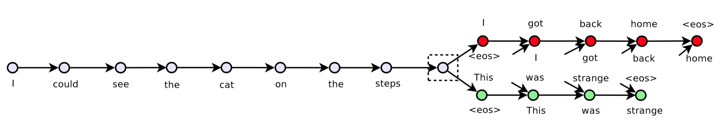
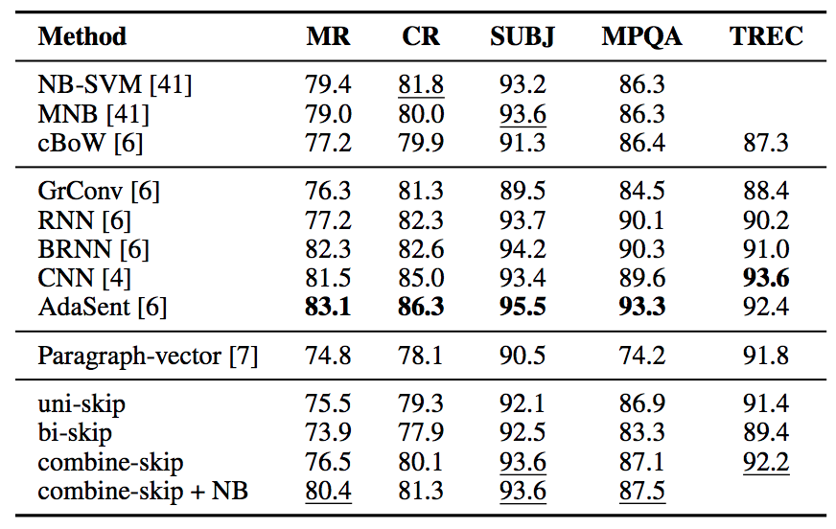
Doc2vec
Skip-Thought Vectors
Predict previous / next sentence with seq2seq model (Kiros et al., 2015)
Hidden state of encoder transfers to sentence tasks (classification, semantic similarity)

Slide 33
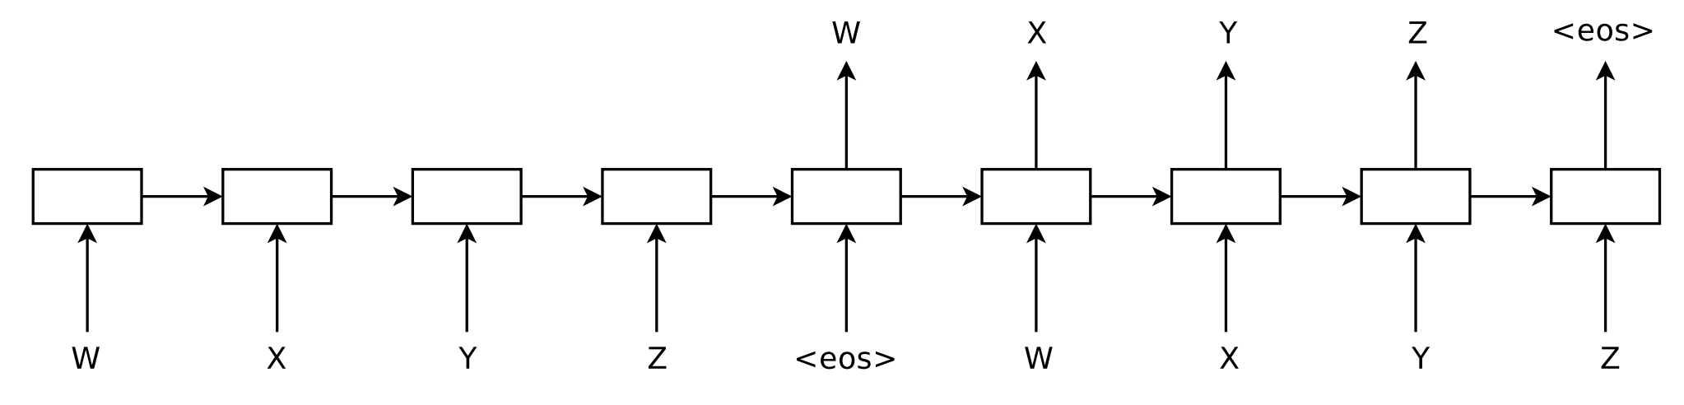
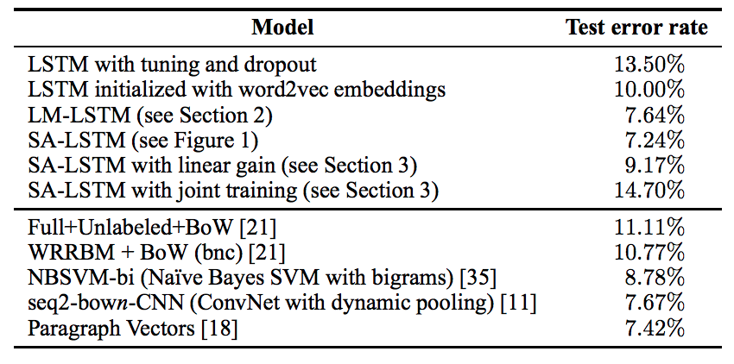
Dai & Le (2015): Pretrain a sequence autoencoder (SA) and generative LM
See also:
Socher et. al (2011): Semi-supervised recursive auto encoder
Bowman et al. (2016): Variational autoencoder (VAE)
Hill et al. (2016): Denoising autoencoder
Autoencoder pretraining
SOTA classification (IMDB)

Slide 34
Autoencoder pretraining
Supervised sentence embeddings
Also possible to train sentence embeddings with supervised objective
Paragram-phrase: uses paraphrase database for supervision, best for paraphrase and semantic similarity (Wieting et al. 2016)
InferSent: bi-LSTM trained on SNLI + MNLI (Conneau et al. 2017)
GenSen: multitask training (skip-thought, machine translation, NLI, parsing) (Subramanian et al. 2018)

Slide 35
Contextual word vectors

Slide 36
Contextual word vectors - Motivation
Word vectors compress all contexts into a single vector
Nearest neighbor GloVe vectors to “play”
VERB
playing
played
NOUN
game
games
players
football
ADJ
multiplayer
??
plays
Play

Slide 37
Contextual word vectors - Key Idea
Instead of learning one vector per word, learn a vector that depends on context
f(play | The kids play a game in the park.)
!=
f(play | The Broadway play premiered yesterday.)
Many approaches based on language models

Slide 38
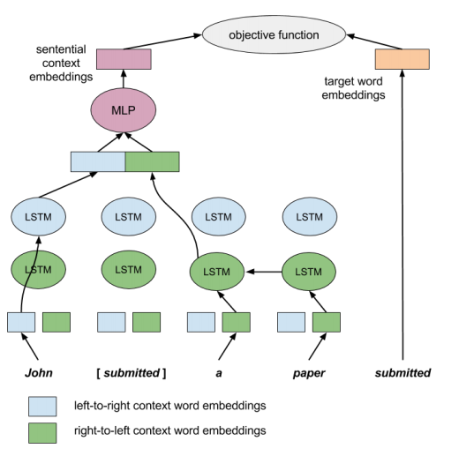
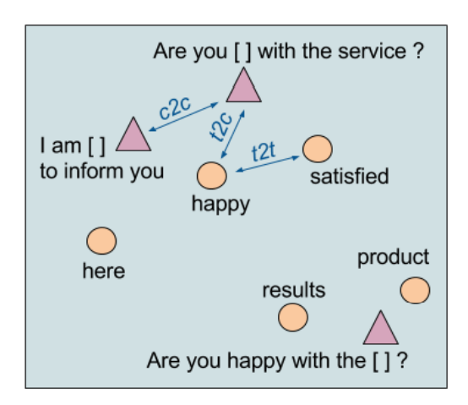
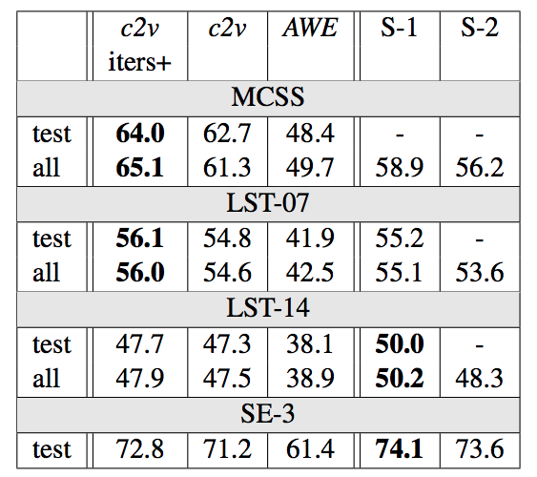
Use bidirectional LSTM and cloze prediction objective (a 1 layer masked LM)
Learn representations for both words and contexts (minus word)
Sentence completion
Lexical substitution
WSD
(Melamud et al., CoNLL 2016)
context2vec

Slide 39
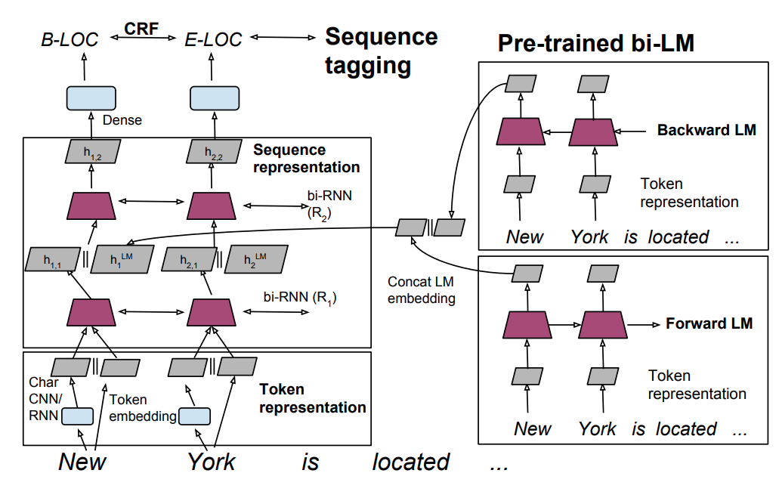
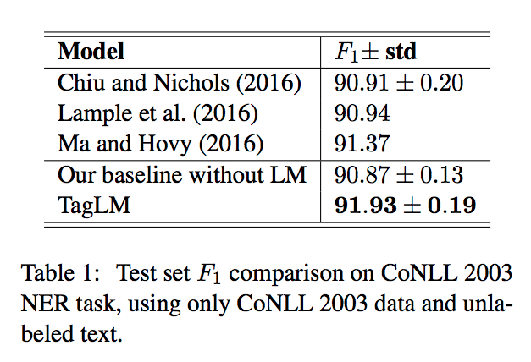
Pretrain two LMs (forward and backward) and add to sequence tagger.
SOTA NER and chunking results
(Peters et al. ACL 2017)
TagLM

Slide 40
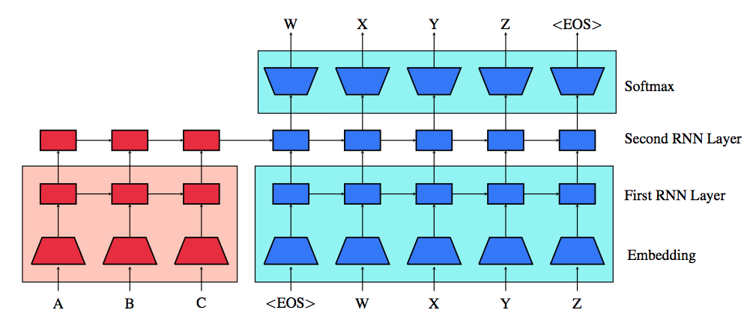
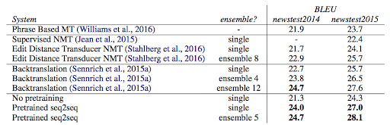
Pretrain encoder and decoder with LMs (everything shaded is pretrained).
Large boost for MT.
(Ramachandran et al, EMNLP 2017)
Unsupervised Pretraining for Seq2Seq

Slide 41
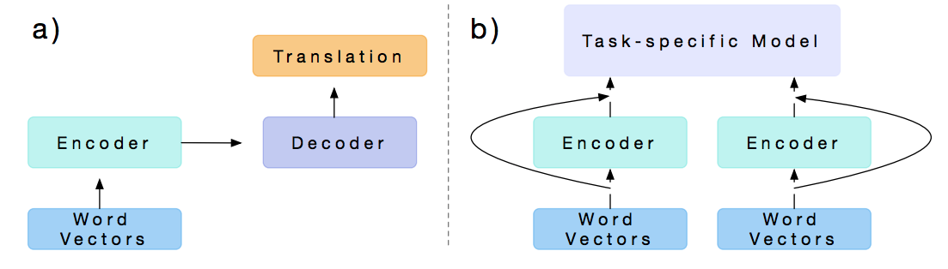
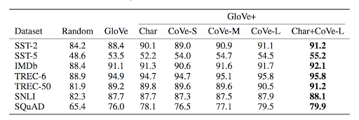
Pretrain bidirectional encoder with MT supervision, extract LSTM states
Adding CoVe with GloVe gives improvements for classification, NLI, Q&A
(McCann et al, NeurIPS 2017)
CoVe

Slide 42
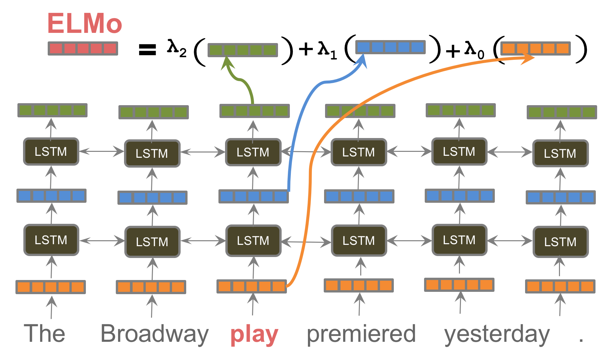
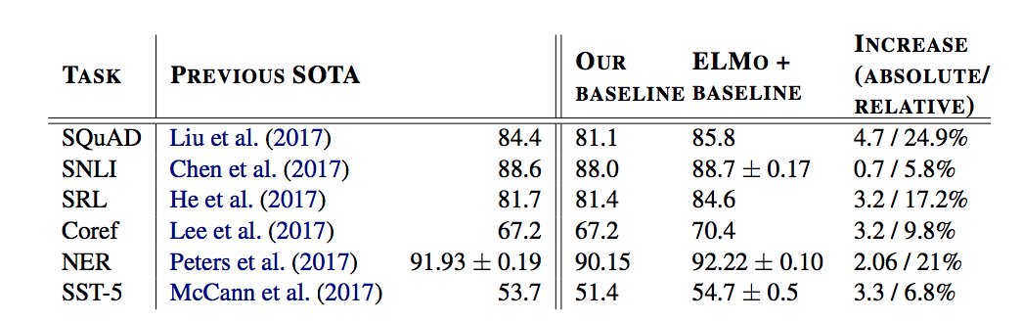
Pretrain deep bidirectional LM, extract contextual word vectors as learned linear combination of hidden states
SOTA for 6 diverse tasks
(Peters et al, NAACL 2018)
ELMo

Slide 43
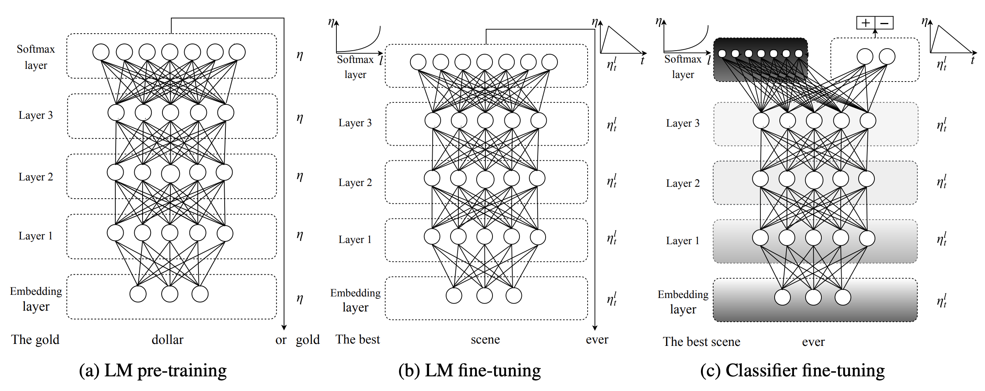
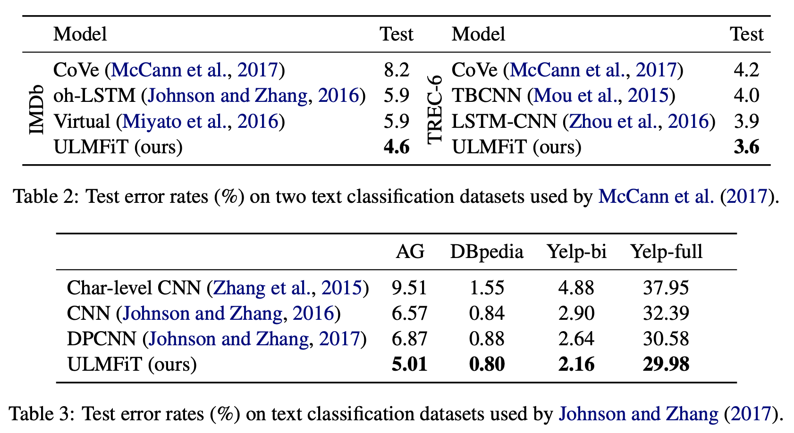
Pretrain AWD-LSTM LM, fine-tune LM in two stages with different adaptation techniques
SOTA for six classification datasets
(Howard and Ruder, ACL 2018)
ULMFiT

Slide 44
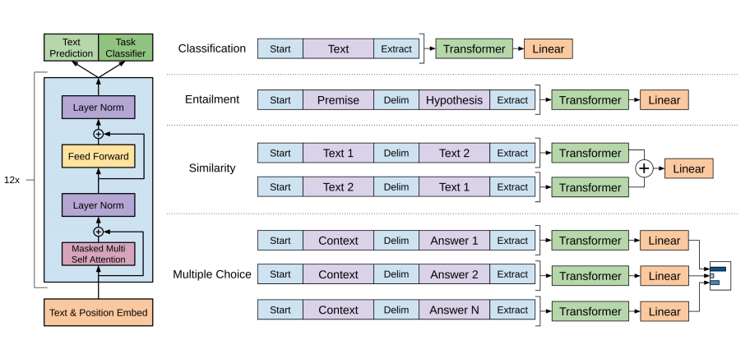
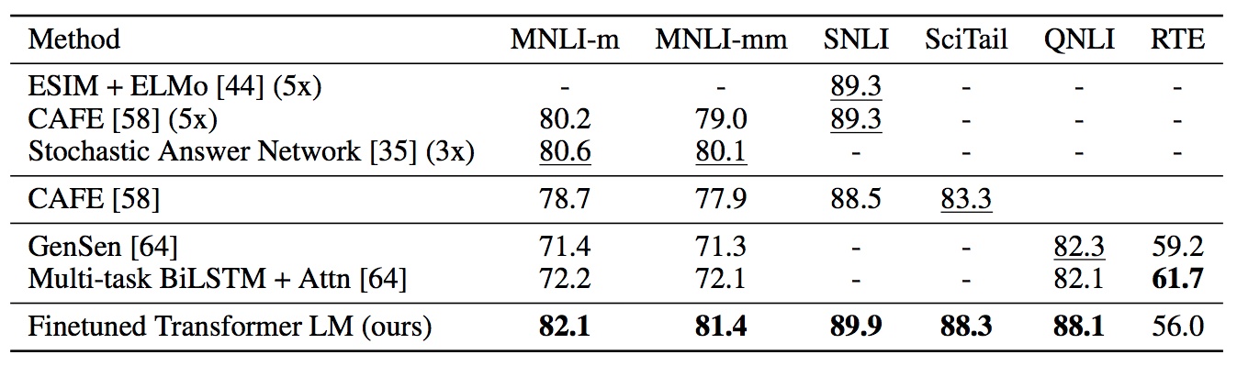
Pretrain large 12-layer left-to-right Transformer, fine tune for sentence, sentence pair and multiple choice questions.
SOTA results for 9 tasks.
(Radford et al., 2018)
GPT

Slide 45
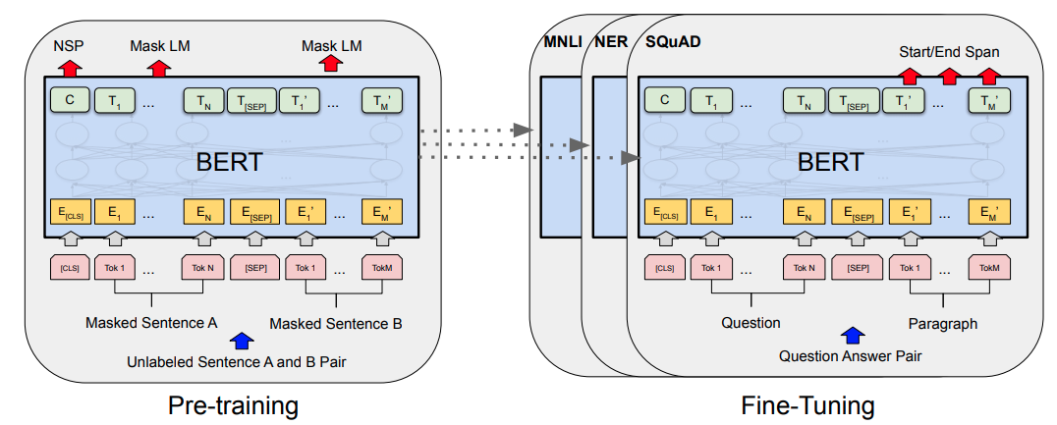
(Devlin et al. 2019)
BERT
BERT pretrains both sentence and contextual word representations,
using masked LM and next sentence prediction.
BERT-large has 340M parameters, 24 layers!
See also: Logeswaran and Lee, ICLR 2018

Slide 46
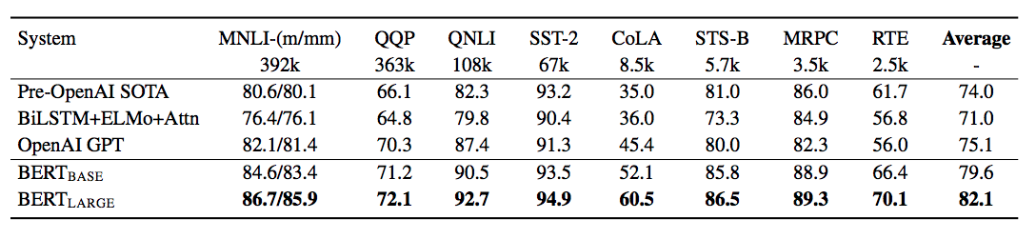
(Devlin et al. 2019)
BERT
SOTA GLUE benchmark results (sentence pair classification).

Slide 47
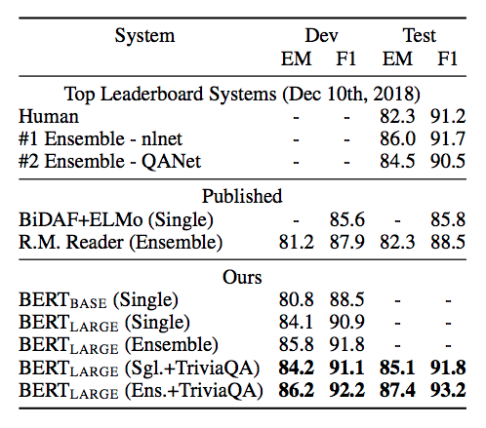
(Devlin et al. 2019)
BERT
SOTA SQuAD v1.1 (and v2.0) Q&A

Slide 48
Other pretraining objectives
Contextual string representations (Akbik et al., COLING 2018)—SOTA NER results
Cross-view training (Clark et al. EMNLP 2018)—improve supervised tasks with unlabeled data
Cloze-driven pretraining (Baevski et al. (2019)—SOTA NER and constituency parsing

Slide 49
Why does language modeling work so well?
Language modeling is a very difficult task, even for humans.
Language models are expected to compress any possible context into a vector that generalizes over possible completions.
“They walked down the street to ???”
To have any chance at solving this task, a model is forced to learn syntax, semantics, encode facts about the world, etc.
Given enough data, a huge model, and enough compute, can do a reasonable job!
Empirically works better than translation, autoencoding: “Language Modeling Teaches You More Syntax than Translation Does” (Zhang et al. 2018)

Slide 50
Sample efficiency

Slide 51
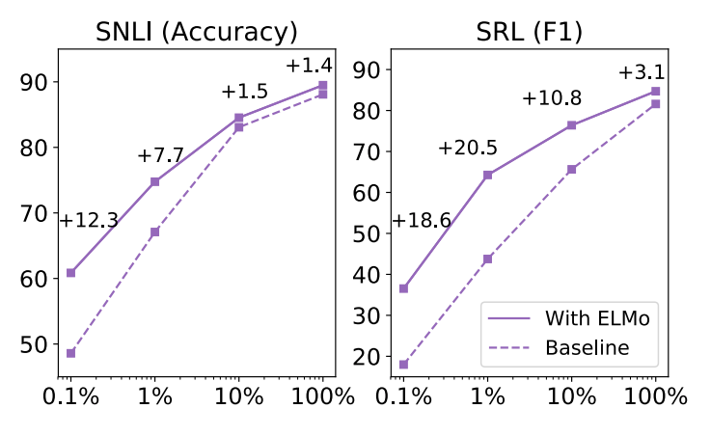
(Peters et al, NAACL 2018)
Pretraining reduces need for annotated data

Slide 52
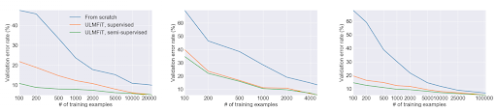
(Howard and Ruder, ACL 2018)
Pretraining reduces need for annotated data

Slide 53
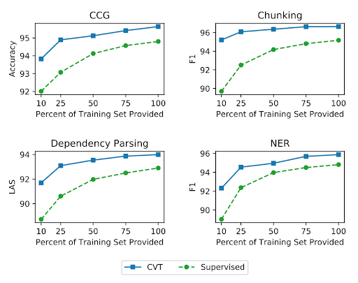
(Clark et al. EMNLP 2018)
Pretraining reduces need for annotated data

Slide 54
Scaling up pretraining

Slide 55
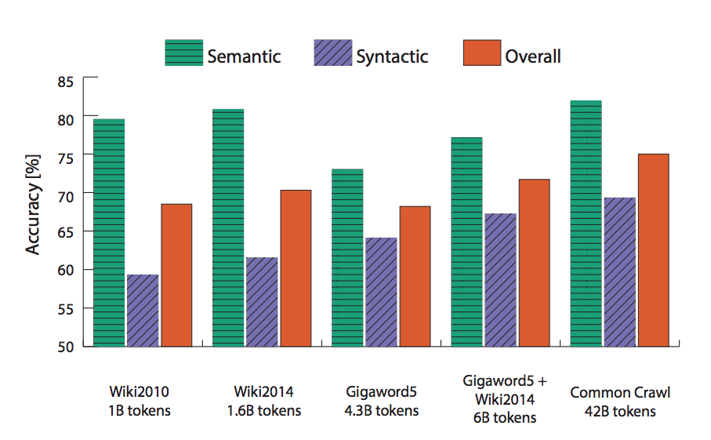
More data → better word vectors
(Pennington et al 2014)
Scaling up pretraining

Slide 56
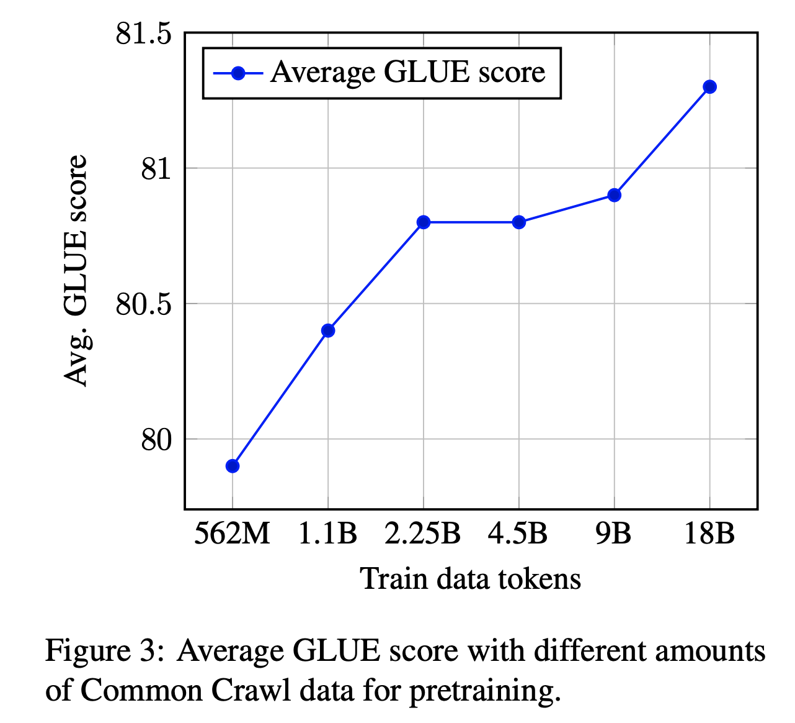
Pretrained Language Models: More Data
Scaling up pretraining
Baevski et al. (2019)

Slide 57
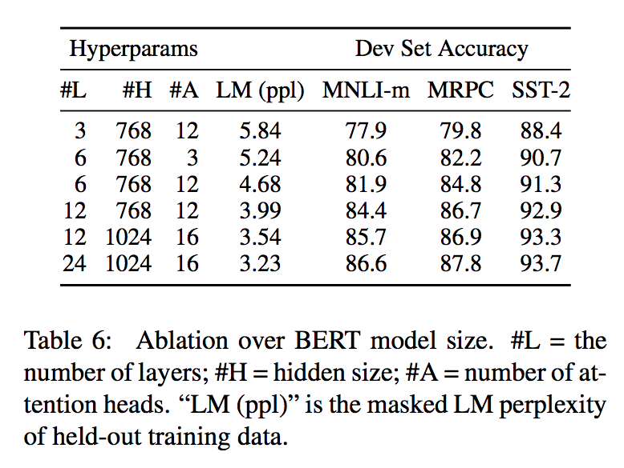
Bigger model → better results
(Devlin et al 2019)
Scaling up pretraining

Slide 58
Cross-lingual pretraining

Slide 59
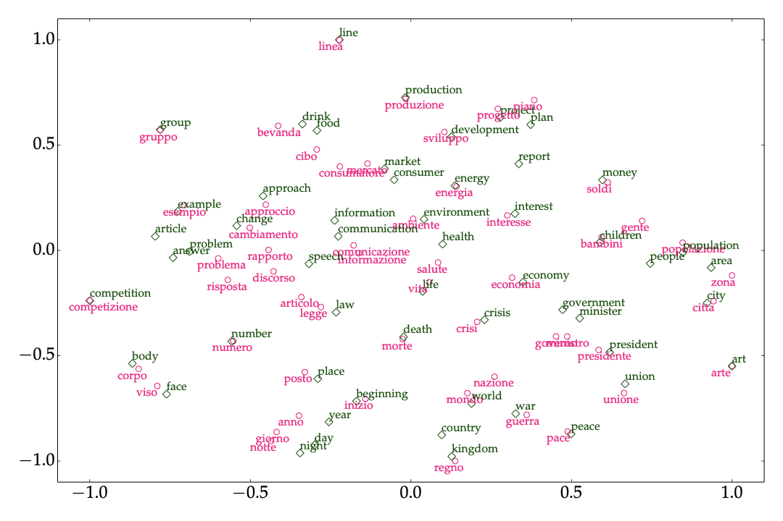
Much work on training cross-lingual word embeddings (Overview: Ruder et al. (2017))
Idea: train each language separately, then align.
Recent work aligning ELMo: Schuster et al., (NAACL 2019)
ACL 2019 Tutorial on Unsupervised Cross-lingual Representation Learning
Cross-lingual pretraining

Slide 60
Cross-lingual Polyglot Pretraining
Key idea: Share vocabulary and representations across languages by training one model on many languages.
Advantages: Easy to implement, enables cross-lingual pretraining by itself
Disadvantages: Leads to under-representation of low-resource languages
LASER: Use parallel data for sentence representations (Artetxe & Schwenk, 2018)
Multilingual BERT: BERT trained jointly on 100 languages
Rosita: Polyglot contextual representations (Mulcaire et al., NAACL 2019)
XLM: Cross lingual LM (Lample & Conneau, 2019)

Slide 61

Hands-on #1:
Pretraining a Transformer Language Model
Image credit: Chanaky

Slide 62
Hands-on: Overview
Current developments in Transfer Learning combine new approaches for training schemes (sequential training) as well as models (transformers) ⇨ can look intimidating and complex
Goals:
Let’s make these recent works “uncool again” i.e. as accessible as possible
Expose all the details in a simple, concise and self-contained code-base
Show that transfer learning can be simple (less hand-engineering) & fast (pretrained model)
Plan
Build a GPT-2 / BERT model
Pretrain it on a rather large corpus with ~100M words
Adapt it for a target task to get SOTA performances
Material:
Colab: http://tiny.cc/NAACLTransferColab ⇨ code of the following slides
Code: http://tiny.cc/NAACLTransferCode ⇨ same code organized in a repo
Notes:
First libraries to include these developments: tensor2tensor/fairseq are great and sota but also large and with a rather steep learning curve

Slide 63
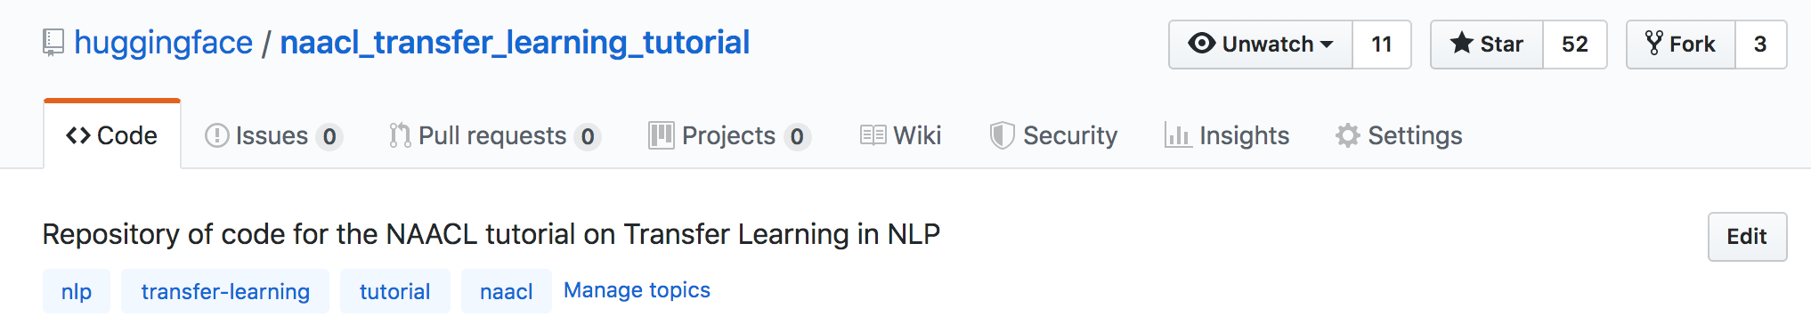
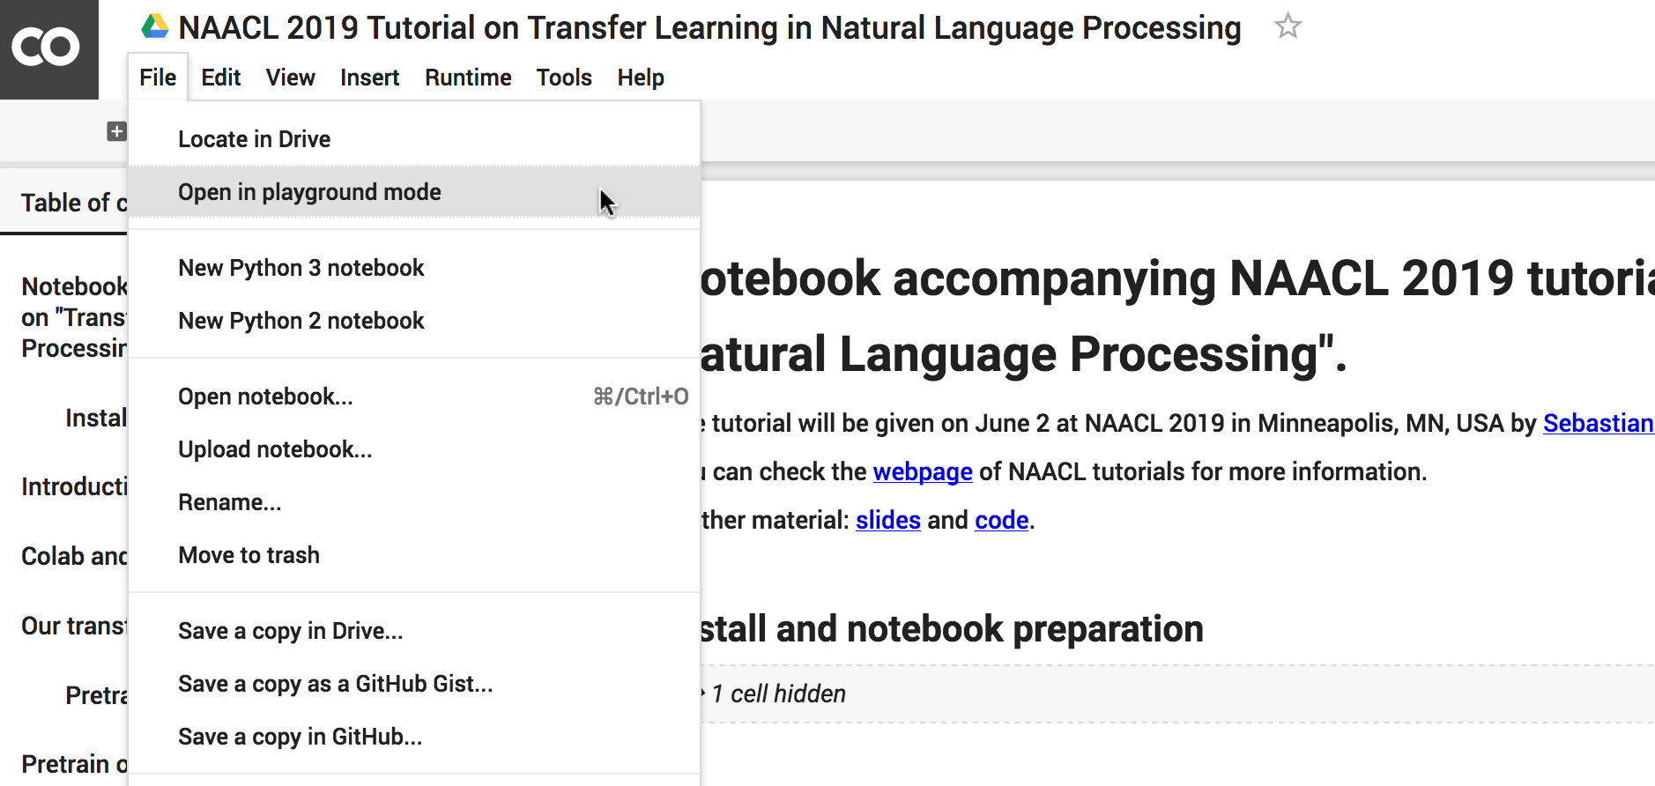
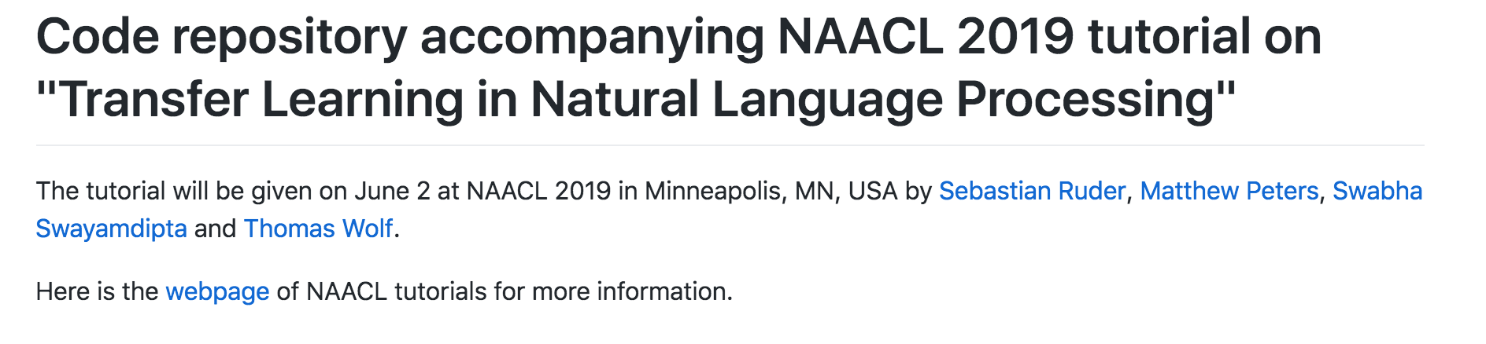
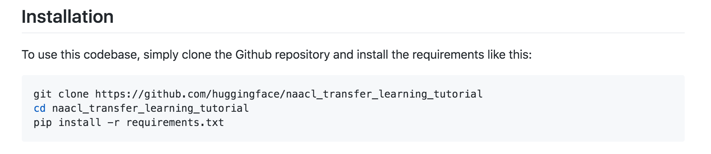
Hands-on pre-training
Colab: http://tiny.cc/NAACLTransferColab
Repo: http://tiny.cc/NAACLTransferCode
Notes:
Pick your side

Slide 64
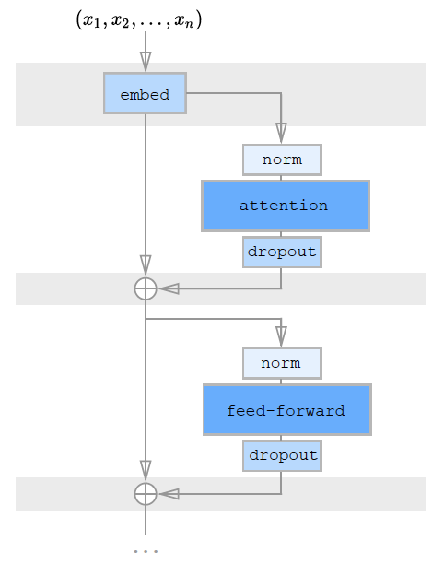
summing words and position embeddings
applying a succession of transformer blocks with:
layer normalisation
a self-attention module
dropout and a residual connection
another layer normalisation
a feed-forward module with one hidden layer and a non linearity: Linear ⇨ ReLU/gelu ⇨ Linear
dropout and a residual connection
The
(Child et al, 2019)
Hands-on pre-training
Our core model will be a Transformer. Large-scale transformer architectures (GPT-2, BERT, XLM…) are very similar to each other and consist of:
Main differences between GPT/GPT-2/BERT are the objective functions:
causal language modeling for GPT
masked language modeling for BERT (+ next sentence prediction)
We’ll play with both

Slide 65
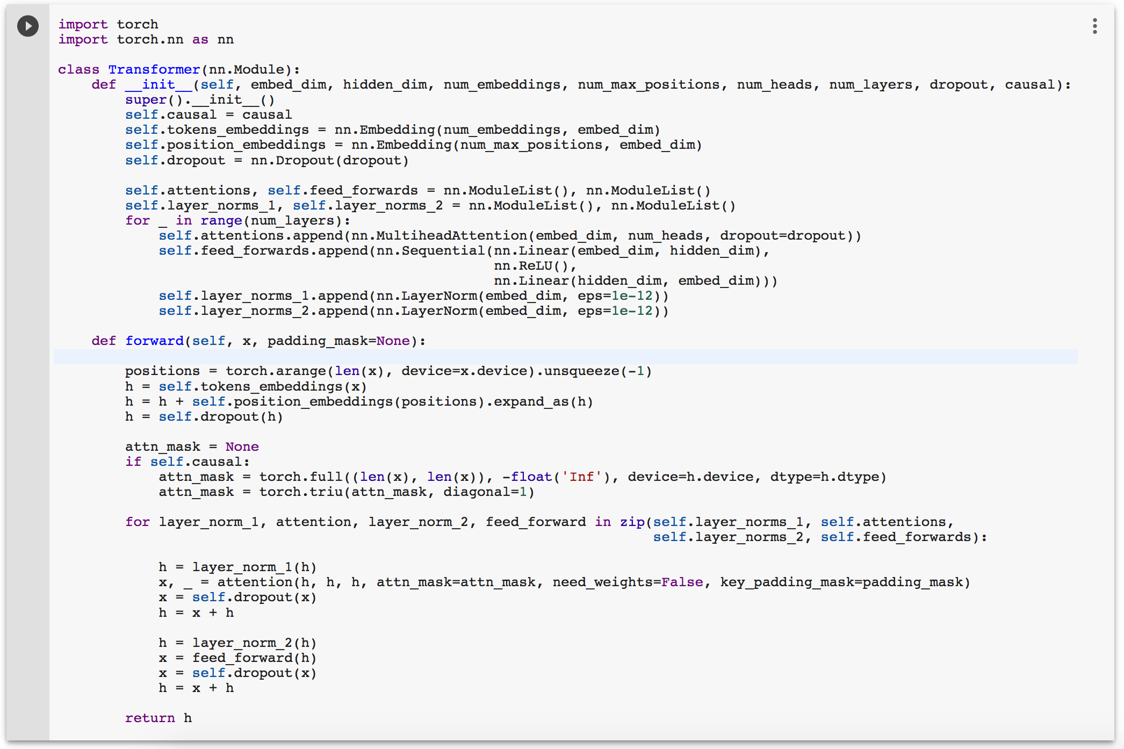
Let’s code the backbone of our model!
PyTorch 1.1 now has a nn.MultiHeadAttention module: lets us encapsulate the self-attention logic while still controlling the internals of the Transformer.
Hands-on pre-training

Slide 66
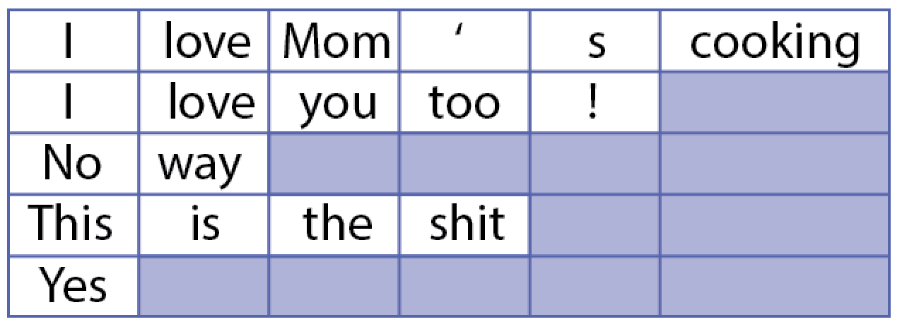
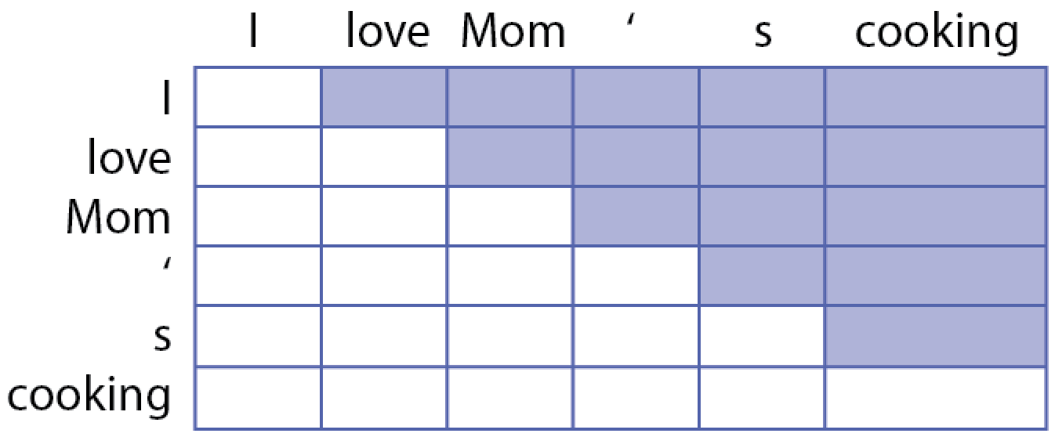
Two attention masks?
padding_mask masks the padding tokens. It is specific to each sample in the batch:
attn_mask is the same for all samples in the batch. It masks the previous tokens for causal transformers:
Hands-on pre-training

Slide 67
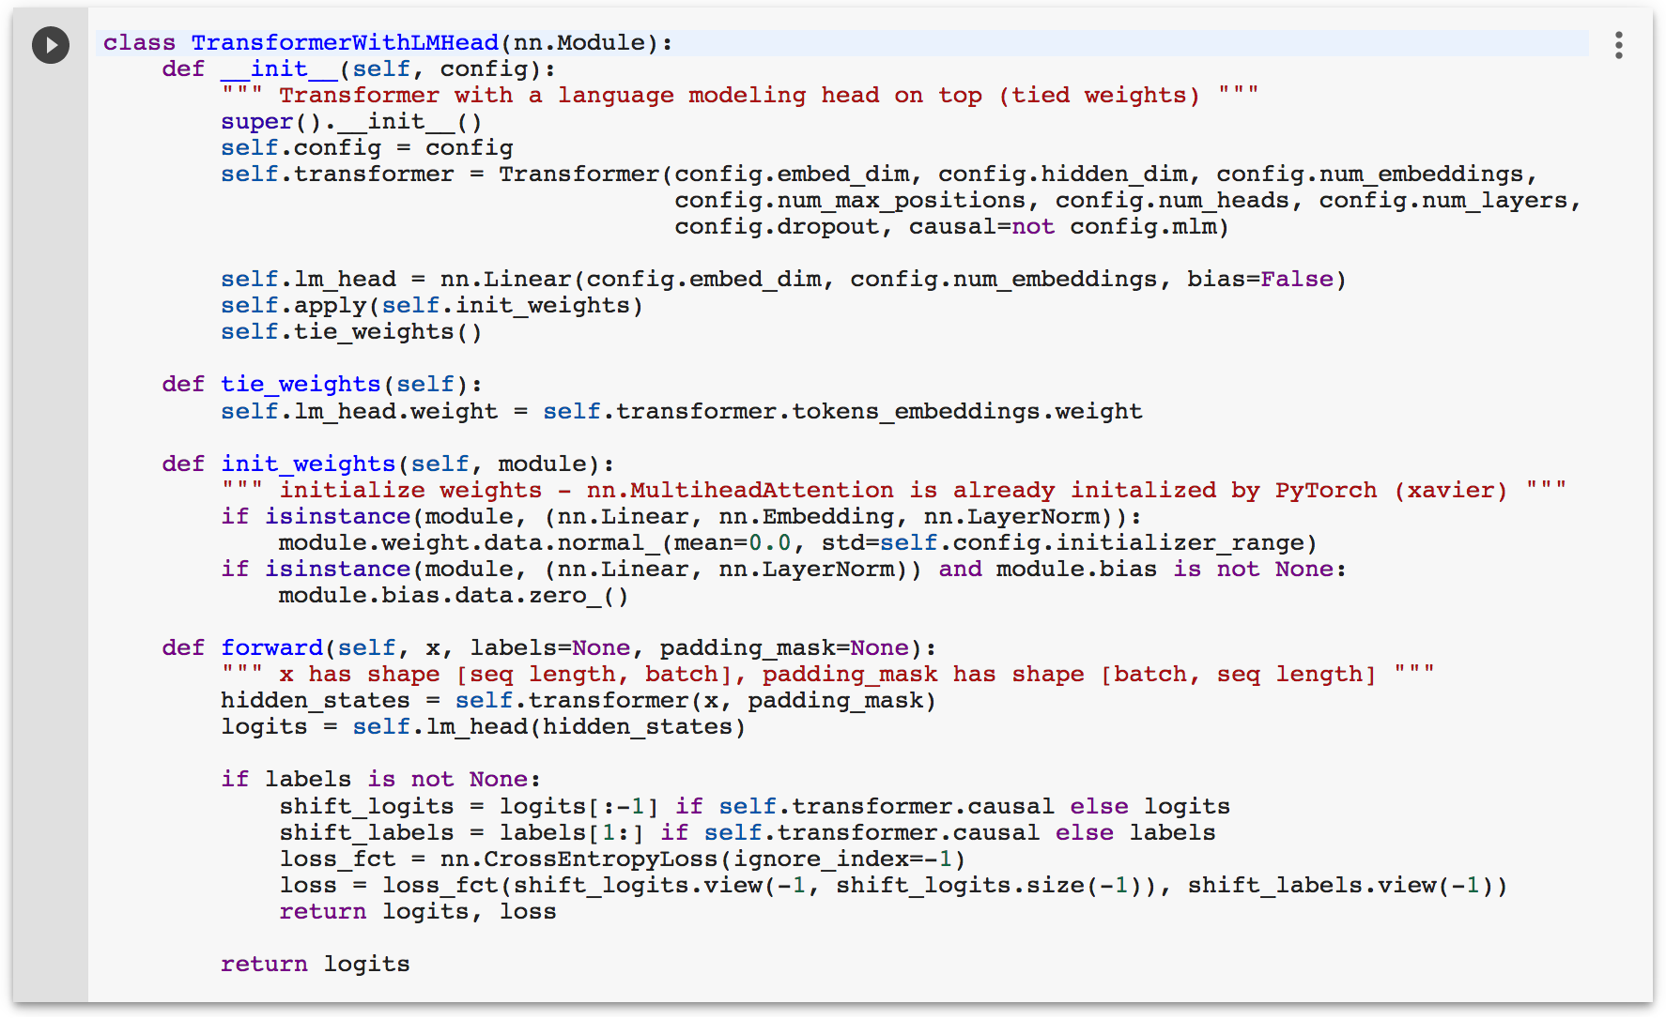
1. A pretraining head on top of our core model: we choose a language modeling head with tied weights
Hands-on pre-training
To pretrain our model, we need to add a few elements: a head, a loss and initialize weights.
We add these elements with a pretraining model encapsulating our model.
2. Initialize the weights
3. Define a loss function: we choose a cross-entropy loss on current (or next) token predictions

Slide 68


Hyper-parameters taken from Dai et al., 2018 (Transformer-XL) ⇨ ~50M parameters causal model.
Use a large dataset for pre-trainining: WikiText-103 with 103M tokens (Merity et al., 2017).
Instantiate our model and optimizer (Adam)
Hands-on pre-training
We'll use a pre-defined open vocabulary tokenizer: BERT’s model cased tokenizer.
Now let’s take care of our data and configuration

Slide 69





Hands-on pre-training
And we’re done: let’s train!
A simple update loop.
We use gradient accumulation to have a large batch size even on 1 GPU (>64).
Learning rate schedule:
- linear warmup to start - then cosine or inverse square root decrease
no warm-up
Go!

Slide 70
Hands-on pre-training — Concluding remarks
On pretraining
Intensive: in our case 5h–20h on 8 V100 GPUs (few days w. 1 V100) to reach a good perplexity ⇨ share your pretrained models
Robust to the choice of hyper-parameters (apart from needing a warm-up for transformers)
Language modeling is a hard task, your model should not have enough capacity to overfit if your dataset is large enough ⇨ you can just start the training and let it run.
Masked-language modeling: typically 2-4 times slower to train than LM We only mask 15% of the tokens ⇨ smaller signal
For the rest of this tutorial We don’t have enough time to do a full pretraining ⇨ we pretrained two models for you before the tutorial
Notes:
First libraries to include these developments: tensor2tensor/fairseq are great and sota but also large and with a rather steep learning curve

Slide 71



Hands-on pre-training — Concluding remarks
First model:
exactly the one we built together ⇨ a 50M parameters causal Transformer
Trained 15h on 8 V100
Reached a word-level perplexity of 29 on wikitext-103 validation set (quite competitive)
Second model:
Same model but trained with a masked-language modeling objective (see the repo)
Trained 30h on 8 V100
Reached a “masked-word” perplexity of 8.3 on wikitext-103 validation set
Wikitext-103 Validation/Test PPL
Dai et al., 2018

Slide 72
Agenda
[1] Introduction
[2] Pretraining
[4] Adaptation
[5] Downstream
[3] What’s in a representation?
[6]
Open Problems

Slide 73
3. What is in a Representation?
Image credit: Caique Lima

Slide 74


Why care about what is in a representation?
Extrinsic evaluation with downstream tasks
Complex, diverse with task-specific quirks
Language-aware representations
To generalize to other tasks, new inputs
As intermediates for possible improvements to pretraining
Interpretability!
Are we getting our results because of the right reasons?
Uncovering biases...
Swayamdipta, 2019
Notes:
Level of abstraction
RepEval 2016 2017 2019

Slide 75







What to analyze?
Embeddings
Word
Contextualized
Network Activations
Variations
Architecture (RNN / Transformer)
Layers
Pretraining Objectives

Slide 76

Analysis Method 1: Visualization
Hold the embeddings / network activations static or frozen

Slide 77



Visualizing Embedding Geometries
Plotting embeddings in a lower dimensional (2D/3D) space
t-SNE van der Maaten & Hinton, 2008
PCA projections
Visualizing word analogies Mikolov et al. 2013
Spatial relations
w_{king} - w_{man} + w_{woman} ~ w_{queen}
High-level view of lexical semantics
Only a limited number of examples
Connection to other tasks is unclear Goldberg, 2017
Pennington et al., 2014
Image: Tensorflow
Notes:
SNE: Stochastic Neighbor Embedding (Hinton & Roweis, 02).
t = technique?
visualizes high-dimensional data by giving each datapoint a location in a two or three-dimensional map
high-dimensional data that lie on several different, but related, low-dimensional manifolds, s
Goes back to Elman 1989,90
Also see: https://distill.pub/2016/misread-tsne/

Slide 78


Visualizing Neuron Activations
Radford et al., 2017
Neuron activation values correlate with features / labels
Indicates learning of recognizable features
How to select which neuron? Hard to scale!
Interpretable != Important (Morcos et al., 2018)
Karpathy et al., 2016
Notes:
( K ́ad ́ar et al., 2017; Qian et al., 2016a) and speech (Wu and King, 2016; Nagamine et al., 2015; Wang et al., 2017b).
Interpretable deepmind - https://deepmind.com/blog/understanding-deep-learning-through-neuron-deletion/

Slide 79

Visualizing Layer-Importance Weights
Layer-wise analysis (static)
How important is each layer for a given performance on a downstream task?
Weighted average of layers
Task and architecture specific!
Also see Tenney et al., ACL 2019
Peters et al.. EMNLP 2018
Notes:
scalar mixing weights tell us which layers, in combination, are most relevant when a probing classifier has access to the whole BERT model.

Slide 80

Visualizing Attention Weights
Visualization: Attention Weights
Popular in machine translation, or other seq2seq architectures:
Alignment between words of source and target.
Long-distance word-word dependencies (intra-sentence attention)
Sheds light on architectures
Having sophisticated attention mechanisms can be a good thing!
Layer-specific
Interpretation can be tricky
Few examples only - cherry picking?
Robust corpus-wide trends? Next!
Vaswani et al., 2017
Notes:
Attention is not explanation: https://arxiv.org/pdf/1902.10186.pdf
Limitations? https://medium.com/@yuvalpinter/attention-is-not-not-explanation-dbc25b534017

Slide 81

Analysis Method 2: Behavioral Probes
RNN-based language models
number agreement in subject-verb dependencies
natural and nonce or ungrammatical sentences
evaluate on output perplexity
RNNs outperform other non-neural baselines.
Performance improves when trained explicitly with syntax (Kuncoro et al. 2018)
Kuncoro et al. 2018
Linzen et al., 2016; Gulordava et al. 2018; Marvin et al., 2018

Slide 82
Analysis Method 2: Behavioral Probes
RNN-based language models (RNN-based)
number agreement in subject-verb dependencies
For natural and nonce/ungrammatical sentences
LM perplexity differences
RNNs outperform other non-neural baselines.
Performance improves when trained explicitly with syntax (Kuncoro et al. 2018)
Probe: Might be vulnerable to co-occurrence biases
“dogs in the neighborhood bark(s)”
Nonce sentences might be too different from original...
Kuncoro et al. 2018
Linzen et al., 2016; Gulordava et al. 2018; Marvin et al., 2018

Slide 83



Analysis Method 3: Classifier Probes
Hold the embeddings / network activations static and
train a simple supervised model on top
Probe classification task (Linear / MLP)

Slide 84
Probing Surface-level Features
Given a sentence, predict properties such as
Length
Is a word in the sentence?
Given a word in a sentence predict properties such as:
Previously seen words, contrast with language model
Position of word in the sentence
Checks ability to memorize
Well-trained, richer architectures tend to fare better
Training on linguistic data memorizes better
Zhang et al. 2018; Liu et al., 2018; Conneau et al., 2018

Slide 85

Probing Morphology, Syntax, Semantics
Sentence-level Syntax
Morphology
Word-level syntax
POS tags, CCG supertags
Constituent parent, grandparent…
Long-distance number agreement
Tree Depth
Subject-Verb Agreement
Top Constituents
Partial syntax
Dependency relations
Partial semantics
Entity Relations
Coreference
Roles
# Objects
Tense of main clause verb
Adi et al., 2017; Conneau et al., 2018; Belinkov et al., 2017; Zhang et al., 2018; Blevins et al., 2018; Tenney et al. 2019; Liu et al., 2019
Notes:
Also Goldberg:19

Slide 86



Probing classifier findings
Liu et al. NAACL 2019
Hewitt et al., 2019
Tenney et al., ACL 2019

Slide 87



Probing classifier findings
Contextualized > non-contextualized
Especially on syntactic tasks
Closer performance on semantic tasks
Bidirectional context is important
BERT (large) almost always gets the highest performance
Grain of salt: Different contextualized representations were trained on different data, using different architectures...
Liu et al. (NAACL 2019)
Hewitt et. al., 2019
Tenney et al., ACL 2019

Slide 88


Probing: Layers of the network
Layer-wise analysis (dynamic)
RNN layers: General linguistic properties
Lowest layers: morphology
Middle layers: syntax
Highest layers: Task-specific semantics
Transformer layers:
Different trends for different tasks; middle-heavy
Also see Tenney et. al., 2019
Fig. from Liu et al. (NAACL 2019)
Notes:
However, patterns are not very clear; sometimes opposite trends show (Zhang et al., 2018).
(larger context—receptive field as in CNNs)
Explain figures in detail.

Slide 89

Probing: Pretraining Objectives
Language modeling outperforms other unsupervised and supervised objectives.
Machine Translation
Dependency Parsing
Skip-thought
Low-resource settings (size of training data) might result in opposite trends.
Zhang et al., 2018; Blevins et al., 2018; Liu et al., 2019;

Slide 90
What have we learnt so far?
Representations are predictive of certain linguistic phenomena:
Alignments in translation, Syntactic hierarchies
Pretraining with and without syntax:
Better performance with syntax
But without, some notion of syntax at least (Williams et al. 2018)
Network architectures determine what is in a representation
Syntax and BERT Transformer (Tenney et al., 2019; Goldberg, 2019)
Different layer-wise trends across architectures

Slide 91
Open questions about probes
What information should a good probe look for?
Probing a probe!
What does probing performance tell us?
Hard to synthesize results across a variety of baselines...
Can introduce some complexity in itself
linear or non-linear classification.
behavioral: design of input sentences
Should we be using probes as evaluation metrics?
might defeat the purpose...

Slide 92



Analysis Method 4: Model Alterations
Progressively erase or mask network components
Word embedding dimensions
Hidden units
Input - words / phrases
Li et al., 2016
Notes:
E.g. Erase entire words to find important words in a sentiment analysis task.
Feng et al., 2018;
Khandelwal et al., 2018;
Bau et al., 2018
Limitations:
Resource heavy! Task-specific models. Not pretraining!

Slide 93

So, what is in a representation?
Depends on how you look at it!
Visualization:
bird’s eye view
few samples -- might call to mind cherry-picking
Probes:
discover corpus-wide specific properties
may introduce own biases...
Network ablations:
great for improving modeling,
could be task specific
Analysis methods as tools to aid model development!

Slide 94

Very current and ongoing!
First column for citations in and before 2015

Slide 95

What’s next?
Linguistic Awareness
Interpretability
Interpretability + transferability to downstream tasks is key
Up next!
Conneau et al., 2018
Correlation of probes to downstream tasks

Slide 96
Some Pointers
Suite of word-based and word-pair-based tasks: Liu et al. 2019 (3B Semantics) https://github.com/nelson-liu/contextual-repr-analysis
Structural Probes: Hewitt & Manning 2019 (9E Machine Learning)
Overview of probes : Belinkov & Glass, 2019 (7F Poster #18)

Slide 97

Break
Image credit: Andrejs Kirma

Slide 98
Agenda
[1] Introduction
[2] Pretraining
[4] Adaptation
[5] Downstream
[3] What’s in a representation?
[6]
Open Problems
Notes:
Introduction (15 mins)
Pretraining (35 mins)
What do the representations capture (30 mins)
Break (15 mins)
Adaptation (30 mins)
Downstream applications (40 mins)
Open problems and directions (20 mins)

Slide 99
4. Adaptation
Image credit: Ben Didier
Notes:
TODO Maybe add a background image here? Of an animal adapting?

Slide 100







4 – How to adapt the pretrained model
Several orthogonal directions we can make decisions on:
Architectural modifications? How much to change the pretrained model architecture for adaptation
Optimization schemes? Which weights to train during adaptation and following what schedule
More signal: Weak supervision, Multi-tasking & Ensembling How to get more supervision signal for the target task
Notes:
TODO add figure that shows comparison of methods

Slide 101

4.1 – Architecture
Two general options:
Keep pretrained model internals unchanged: Add classifiers on top, embeddings at the bottom, use outputs as features
Modify pretrained model internal architecture: Initialize encoder-decoders, task-specific modifications, adapters
Image credit: Darmawansyah
Notes:
Image of modifications on a next slide This is a test.

Slide 102
4.1.A – Architecture: Keep model unchanged
General workflow:
Remove pretraining task head if not useful for target task
Example: remove softmax classifier from pretrained LM
Not always needed: some adaptation schemes re-use the pretraining objective/task, e.g. for multi-task learning
Notes:
Image of modifications on a next slide This is a test.

Slide 103
4.1.A – Architecture: Keep model unchanged
Task-specific, randomly initialized
General workflow:
Add target task-specific layers on top/bottom of pretrained model
Simple: adding linear layer(s) on top of the pretrained model
General, pretrained
Notes:
Image of modifications on a next slide This is a test.

Slide 104
4.1.A – Architecture: Keep model unchanged
General workflow:
Add target task-specific layers on top/bottom of pretrained model
Simple: adding linear layer(s) on top of the pretrained model
More complex: model output as input for a separate model
Often beneficial when target task requires interactions that are not available in pretrained embedding
Notes:
Image of modifications on a next slide This is a test.

Slide 105

4.1.B – Architecture: Modifying model internals
Various reasons:
Adapting to a structurally different target task
Ex: Pretraining with a single input sequence (ex: language modeling) but adapting to a task with several input sequences (ex: translation, conditional generation...)
Use the pretrained model weights to initialize as much as possible of a structurally different target task model
Ex: Use monolingual LMs to initialize encoder and decoder parameters for MT (Ramachandran et al., EMNLP 2017; Lample & Conneau, 2019)

Slide 106
4.1.B – Architecture: Modifying model internals
Various reasons:
Task-specific modifications
Provide pretrained model with capabilities that are useful for the target task
Ex: Adding skip/residual connections, attention (Ramachandran et al., EMNLP 2017)

Slide 107



4.1.B – Architecture: Modifying model internals
Various reasons:
Using less parameters for adaptation:
Less parameters to fine-tune
Can be very useful given the increasing size of model parameters
Ex: add bottleneck modules (“adapters”) between the layers of the pretrained model (Rebuffi et al., NIPS 2017; CVPR 2018)

Slide 108
4.1.B – Architecture: Modifying model internals
Adapters
Commonly connected with a residual connection in parallel to an existing layer
Most effective when placed at every layer (smaller effect at bottom layers)
Different operations (convolutions, self-attention) possible
Particularly suitable for modular architectures like Transformers (Houlsby et al., ICML 2019; Stickland and Murray, ICML 2019)
Image credit: Caique Lima

Slide 109



4.1.B – Architecture: Modifying model internals
Adapters (Stickland & Murray, ICML 2019)
Multi-head attention (MH; shared across layers) is used in parallel with self-attention (SA) layer of BERT
Both are added together and fed into a layer-norm (LN)

Slide 110
Hands-on #2:
Adapting our pretrained model
Image credit: Chanaky
Notes:
TODO add figure that shows comparison of methods

Slide 111
Hands-on: Model adaptation
Let’s see how a simple fine-tuning scheme can be implemented with our pretrained model:
Plan
Start from our Transformer language model
Adapt the model to a target task:
keep the model core unchanged, load the pretrained weights
add a linear layer on top, newly initialized
use additional embeddings at the bottom, newly initialized
Reminder — material is here:
Colab http://tiny.cc/NAACLTransferColab ⇨ code of the following slides
Code http://tiny.cc/NAACLTransferCode ⇨ same code in a repo

Slide 112

Adaptation task
We select a text classification task as the downstream task
TREC-6: The Text REtrieval Conference (TREC) Question Classification (Li et al., COLING 2002)
TREC consists of open-domain, fact-based questions divided into broad semantic categories contains 5500 labeled training questions & 500 testing questions with 6 labels: NUM, LOC, HUM, DESC, ENTY, ABBR
(Howard and Ruder, ACL 2018)
Hands-on: Model adaptation
Ex:
How did serfdom develop in and then leave Russia ? —> DESC
What films featured the character Popeye Doyle ? —> ENTY
Transfer learning models shine on this type of low-resource task

Slide 113
Modifications:
Keep model internals unchanged
Add a linear layer on top
Add an additional embedding (classification token) at the bottom
Computation flow:
Model input: the tokenized question with a classification token at the end
Extract the last hidden-state associated to the classification token
Pass the hidden-state in a linear layer and softmax to obtain class probabilities
(Radford et al., 2018)
Hands-on: Model adaptation
First adaptation scheme

Slide 114



Fine-tuning hyper-parameters:
– 6 classes in TREC-6
– Use fine tuning hyper parameters from Radford et al., 2018:
learning rate from 6.5e-5 to 0.0
fine-tune for 3 epochs
Let’s load and prepare our dataset:
Hands-on: Model adaptation
- trim to the transformer input size & add a classification token at the end of each sample,
- pad to the left,
- convert to tensors,
- extract a validation set.

Slide 115


Adapt our model architecture
Keep our pretrained model unchanged as the backbone.
Replace the pre-training head (language modeling) with the classification head:
A linear layer, which takes as input the hidden-state of the [CLF] token (using a mask)
* Initialize all the weights of the model.
Hands-on: Model adaptation
* Reload common weights from the pretrained model.

Slide 116


Our fine-tuning code:
A simple training update function:
* prepare inputs: transpose and build padding & classification token masks
* we have options to clip and accumulate gradients
We will evaluate on our validation and test sets:
* validation: after each epoch
* test: at the end
Schedule:
* linearly increasing to lr
* linearly decreasing to 0.0
Hands-on: Model adaptation

Slide 117

We can now fine-tune our model on TREC:
We are at the state-of-the-art
(ULMFiT)
Remarks:
The error rate goes down quickly! After one epoch we already have >90% accuracy. ⇨ Fine-tuning is highly data efficient in Transfer Learning
We took our pre-training & fine-tuning hyper-parameters straight from the literature on related models. ⇨ Fine-tuning is often robust to the exact choice of hyper-parameters
Hands-on: Model adaptation – Results

Slide 118

Let’s conclude this hands-on with a few additional words on robustness & variance.
Large pretrained models (e.g. BERT large) are prone to degenerate performance when fine-tuned on tasks with small training sets.
Observed behavior is often “on-off”: it either works very well or doesn’t work at all.
Understanding the conditions and causes of this behavior (models, adaptation schemes) is an open research question.
Hands-on: Model adaptation – Results
Phang et al., 2018

Slide 119




4.2 – Optimization
Several directions when it comes to the optimization itself:
Choose which weights we should update Feature extraction, fine-tuning, adapters
Choose how and when to update the weights From top to bottom, gradual unfreezing, discriminative fine-tuning
Consider practical trade-offs Space and time complexity, performance
Image credit: ProSymbols, purplestudio, Markus, Alfredo

Slide 120
4.2.A – Optimization: Which weights?
The main question: To tune or not to tune (the pretrained weights)?
Do not change pretrained weights Feature extraction, adapters
Change pretrained weights Fine-tuning
Image credit: purplestudio

Slide 121

4.2.A – Optimization: Which weights?
Don’t touch the pretrained weights! Feature extraction:
Weights are frozen
❄️

Slide 122

4.2.A – Optimization: Which weights?
Don’t touch the pretrained weights! Feature extraction:
Weights are frozen
A linear classifier is trained on top of the pretrained representations
❄️

Slide 123
4.2.A – Optimization: Which weights?
Don’t touch the pretrained weights! Feature extraction:
Weights are frozen
A linear classifier is trained on top of the pretrained representations
Don’t just use features of the top layer!
Learn a linear combination of layers (Peters et al., NAACL 2018, Ruder et al., AAAI 2019)
❄️

Slide 124
4.2.A – Optimization: Which weights?
Don’t touch the pretrained weights!
Feature extraction:
Alternatively, pretrained representations are used as features in downstream model

Slide 125
4.2.A – Optimization: Which weights?
Don’t touch the pretrained weights! Adapters
Task-specific modules that are added in between existing layers

Slide 126
4.2.A – Optimization: Which weights?
Don’t touch the pretrained weights! Adapters
Task-specific modules that are added in between existing layers
Only adapters are trained

Slide 127
4.2.A – Optimization: Which weights?
Yes, change the pretrained weights!
Fine-tuning:
Pretrained weights are used as initialization for parameters of the downstream model
The whole pretrained architecture is trained during the adaptation phase

Slide 128
Hands-on #3:
Using Adapters and freezing
Image credit: Chanaky
Notes:
TODO add figure that shows comparison of methods

Slide 129

Modifications:
add Adapters inside the backbone model: Linear ⇨ ReLU ⇨ Linear with a skip-connection
As previously:
add a linear layer on top
use an additional embedding (classification token) at the bottom
Hands-on: Model adaptation
Second adaptation scheme: Using Adapters
We will only train the adapters, the added linear layer and the embeddings. The other parameters of the model will be frozen.
Houlsby et al., ICML 2019

Slide 130

Let’s adapt our model architecture
Inherit from our pretrained model to have all the modules.
Add the adapter modules:
Bottleneck layers with 2 linear layers and a non-linear activation function (ReLU)
Hidden dimension is small: e.g. 32, 64, 256
The Adapters are inserted inside skip-connections after:
the attention module
the feed-forward module
Hands-on: Model adaptation

Slide 131

Now we need to freeze the portions of our model we don’t want to train.
We just indicate that no gradient is needed for the frozen parameters by setting param.requires_grad to False for the frozen parameters:
In our case we will train 25% of the parameters. The model is small & deep (many adapters) and we need to train the embeddings so the ratio stay quite high. For a larger model this ratio would be a lot lower.
Hands-on: Model adaptation

Slide 132

We use a hidden dimension of 32 for the adapters and a learning rate ten times higher for the fine-tuning (we have added quite a lot of newly initialized parameters to train from scratch).
Results similar to full-fine-tuning case with advantage of training only 25% of the full model parameters.
For a small 50M parameters model this method is overkill ⇨ for 300M–1.5B parameters models.
Hands-on: Model adaptation

Slide 133
4.2.B – Optimization: What schedule?
We have decided which weights to update, but in which order and how should be update them?
Motivation: We want to avoid overwriting useful pretrained information and maximize positive transfer.
Related concept: Catastrophic forgetting (McCloskey & Cohen, 1989; French, 1999) When a model forgets the task it was originally trained on.
Image credit: Markus

Slide 134
4.2.B – Optimization: What schedule?
A guiding principle: Update from top-to-bottom
Progressively in time: freezing
Progressively in intensity: Varying the learning rates
Progressively vs. the pretrained model: Regularization

Slide 135
4.2.B – Optimization: Freezing
Main intuition: Training all layers at the same time on data of a different distribution and task may lead to instability and poor solutions.
Solution: Train layers individually to give them time to adapt to new task and data.
Goes back to layer-wise training of early deep neural networks (Hinton et al., 2006; Bengio et al., 2007).
Notes:
TODO: add some motivation for freezing

Slide 136
4.2.B – Optimization: Freezing
Freezing all but the top layer (Long et al., ICML 2015)
Notes:
TODO: add some motivation for freezing

Slide 137
4.2.B – Optimization: Freezing
Freezing all but the top layer (Long et al., ICML 2015)
Chain-thaw (Felbo et al., EMNLP 2017): training one layer at a time
Train new layer
Notes:
TODO: add some motivation for freezing

Slide 138
4.2.B – Optimization: Freezing
Freezing all but the top layer (Long et al., ICML 2015)
Chain-thaw (Felbo et al., EMNLP 2017): training one layer at a time
Train new layer
Train one layer at a time
Notes:
TODO: add some motivation for freezing

Slide 139
4.2.B – Optimization: Freezing
Freezing all but the top layer (Long et al., ICML 2015)
Chain-thaw (Felbo et al., EMNLP 2017): training one layer at a time
Train new layer
Train one layer at a time
Notes:
TODO: add some motivation for freezing

Slide 140
4.2.B – Optimization: Freezing
Freezing all but the top layer (Long et al., ICML 2015)
Chain-thaw (Felbo et al., EMNLP 2017): training one layer at a time
Train new layer
Train one layer at a time
Notes:
TODO: add some motivation for freezing

Slide 141
4.2.B – Optimization: Freezing
Freezing all but the top layer (Long et al., ICML 2015)
Chain-thaw (Felbo et al., EMNLP 2017): training one layer at a time
Train new layer
Train one layer at a time
Train all layers
Notes:
TODO: add some motivation for freezing

Slide 142
4.2.B – Optimization: Freezing
Freezing all but the top layer (Long et al., ICML 2015)
Chain-thaw (Felbo et al., EMNLP 2017): training one layer at a time
Gradually unfreezing (Howard & Ruder, ACL 2018): unfreeze one layer after another
Notes:
TODO: add some motivation for freezing

Slide 143
4.2.B – Optimization: Freezing
Freezing all but the top layer (Long et al., ICML 2015)
Chain-thaw (Felbo et al., EMNLP 2017): training one layer at a time
Gradually unfreezing (Howard & Ruder, ACL 2018): unfreeze one layer after another
Notes:
TODO: add some motivation for freezing

Slide 144
4.2.B – Optimization: Freezing
Freezing all but the top layer (Long et al., ICML 2015)
Chain-thaw (Felbo et al., EMNLP 2017): training one layer at a time
Gradually unfreezing (Howard & Ruder, ACL 2018): unfreeze one layer after another
Notes:
TODO: add some motivation for freezing

Slide 145
4.2.B – Optimization: Freezing
Freezing all but the top layer (Long et al., ICML 2015)
Chain-thaw (Felbo et al., EMNLP 2017): training one layer at a time
Gradually unfreezing (Howard & Ruder, ACL 2018): unfreeze one layer after another
Notes:
TODO: add some motivation for freezing

Slide 146
4.2.B – Optimization: Freezing
Freezing all but the top layer (Long et al., ICML 2015)
Chain-thaw (Felbo et al., EMNLP 2017): training one layer at a time
Gradually unfreezing (Howard & Ruder, ACL 2018): unfreeze one layer after another
Sequential unfreezing (Chronopoulou et al., NAACL 2019): hyper-parameters that determine length of fine-tuning
Fine-tune additional parameters for epochs
Notes:
TODO: add some motivation for freezing

Slide 147
4.2.B – Optimization: Freezing
Freezing all but the top layer (Long et al., ICML 2015)
Chain-thaw (Felbo et al., EMNLP 2017): training one layer at a time
Gradually unfreezing (Howard & Ruder, ACL 2018): unfreeze one layer after another
Sequential unfreezing (Chronopoulou et al., NAACL 2019): hyper-parameters that determine length of fine-tuning
Fine-tune additional parameters for epochs
Fine-tune pretrained parameters without embedding layer for epochs
Notes:
TODO: add some motivation for freezing

Slide 148
4.2.B – Optimization: Freezing
Freezing all but the top layer (Long et al., ICML 2015)
Chain-thaw (Felbo et al., EMNLP 2017): training one layer at a time
Gradually unfreezing (Howard & Ruder, ACL 2018): unfreeze one layer after another
Sequential unfreezing (Chronopoulou et al., NAACL 2019): hyper-parameters that determine length of fine-tuning
Fine-tune additional parameters for epochs
Fine-tune pretrained parameters without embedding layer for epochs
Train all layers until convergence
Notes:
TODO: add some motivation for freezing

Slide 149
4.2.B – Optimization: Freezing
Freezing all but the top layer (Long et al., ICML 2015)
Chain-thaw (Felbo et al., EMNLP 2017): training one layer at a time
Gradually unfreezing (Howard & Ruder, ACL 2018): unfreeze one layer after another
Sequential unfreezing (Chronopoulou et al., NAACL 2019): hyper-parameters that determine length of fine-tuning
Commonality: Train all parameters jointly in the end
Notes:
TODO: add some motivation for freezing

Slide 150
Hands-on #4:
Using gradual unfreezing
Image credit: Chanaky
Notes:
TODO add figure that shows comparison of methods

Slide 151


Gradual unfreezing is similar to our previous freezing process. We start by freezing all the model except the newly added parameters:
We then gradually unfreeze an additional block along the training so that we train the full model at the end:
Unfreezing interval
Find index of layer to unfreeze
Name pattern matching
Hands-on: Adaptation

Slide 152

Gradual unfreezing has not been investigated in details for Transformer models ⇨ no specific hyper-parameters advocated in the literature
Residual connections may have an impact on the method
⇨ should probably adapt LSTM hyper-parameters
Hands-on: Adaptation
We show simple experiments in the Colab. Better hyper-parameters settings can probably be found.

Slide 153




4.2.B – Optimization: Learning rates
Main idea: Use lower learning rates to avoid overwriting useful information.
Where and when?
Lower layers (capture general information)
Early in training (model still needs to adapt to target distribution)
Late in training (model is close to convergence)

Slide 154

4.2.B – Optimization: Learning rates
Discriminative fine-tuning (Howard & Ruder, ACL 2018)
Lower layers capture general information → Use lower learning rates for lower layers

Slide 155
4.2.B – Optimization: Learning rates
Discriminative fine-tuning
Triangular learning rates (Howard & Ruder, ACL 2018)
Quickly move to a suitable region, then slowly converge over time

Slide 156
4.2.B – Optimization: Learning rates
Discriminative fine-tuning
Triangular learning rates (Howard & Ruder, ACL 2018)
Quickly move to a suitable region, then slowly converge over time
Also known as “learning rate warm-up”
Used e.g. in Transformer (Vaswani et al., NIPS 2017) and Transformer-based methods (BERT, GPT)
Facilitates optimization; easier to escape suboptimal local minima

Slide 157

4.2.B – Optimization: Regularization
Main idea: minimize catastrophic forgetting by encouraging target model parameters to stay close to pretrained model parameters using a regularization term .

Slide 158

4.2.B – Optimization: Regularization
Simple method: Regularize new parameters not to deviate too much from pretrained ones (Wiese et al., CoNLL 2017):

Slide 159



4.2.B – Optimization: Regularization
More advanced (elastic weight consolidation; EWC): Focus on parameters that are important for the pretrained task based on the Fisher information matrix (Kirkpatrick et al., PNAS 2017):

Slide 160
4.2.B – Optimization: Regularization
EWC has downsides in continual learning:
May over-constrain parameters
Computational cost is linear in the number of tasks (Schwarz et al., ICML 2018)

Slide 161


4.2.B – Optimization: Regularization
If tasks are similar, we may also encourage source and target predictions to be close based on cross-entropy, similar to distillation:

Slide 162
Hands-on #5:
Using discriminative learning
Image credit: Chanaky
Notes:
TODO add figure that shows comparison of methods

Slide 163







Discriminative learning rate can be implemented using two steps in our example:
First we organize the parameters of the various layers in labelled parameters groups in the optimizer:
We can then compute the learning rate of each group depending on its label (at each training iteration):
Hyper-parameter
Hands-on: Model adaptation

Slide 164
4.2.C – Optimization: Trade-offs
Several trade-offs when choosing which weights to update:
Space complexity Task-specific modifications, additional parameters, parameter reuse
Time complexity Training time
Performance
Image credit: Alfredo

Slide 165
4.2.C – Optimization trade-offs: Space
Task-specific modifications
Feature extraction
Adapters
Fine-tuning
Many
Few
Additional parameters
Feature extraction
Adapters
Fine-tuning
Many
Few
Feature extraction
Adapters
Fine-tuning
Parameter reuse
All
None
Notes:
Task-specific modifications:
Feature extraction often requires many modifications, e.g. a separate model on top
Adapters only a few task-specific modules
Fine-tuning adds only a few extra parameters on top

Slide 166
4.2.C – Optimization trade-offs: Time
Training time
Feature extraction
Adapters
Fine-tuning
Slow
Fast
Notes:
Training time is typically a function of the number of parameters that need to be trained from scratch

Slide 167
4.2.C – Optimization trade-offs: Performance
Rule of thumb: If task source and target tasks are dissimilar*, use feature extraction (Peters et al., 2019)
Otherwise, feature extraction and fine-tuning often perform similar
Fine-tuning BERT on textual similarity tasks works significantly better
Adapters achieve performance competitive with fine-tuning
Anecdotally, Transformers are easier to fine-tune (less sensitive to hyper-parameters) than LSTMs
*dissimilar: certain capabilities (e.g. modelling inter-sentence relations) are beneficial for target task, but pretrained model lacks them (see more later)

Slide 168

4.3 – Getting more signal
The target task is often a low-resource task. We can often improve the performance of transfer learning by combining a diverse set of signals:
From fine-tuning a single model on a single adaptation task…. The Basic: fine-tuning the model with a simple classification objective
… to gathering signal from other datasets and related tasks … Fine-tuning with Weak Supervision, Multi-tasking and Sequential Adaptation
… to ensembling models Combining the predictions of several fine-tuned models
Image credit: Naveen

Slide 169


4.3.A – Getting more signal: Basic fine-tuning
Simple example of fine-tuning on a text classification task:
Extract a single fixed-length vector from the model: hidden state of first/last token or mean/max of hidden-states
Project to the classification space with an additional classifier
Train with a classification objective

Slide 170
4.3.B – Getting more signal: Related datasets/tasks
Sequential adaptation Intermediate fine-tuning on related datasets and tasks
Multi-task fine-tuning with related tasks Such as NLI tasks in GLUE
Dataset Slicing When the model consistently underperforms on particular slices of the data
Semi-supervised learning Use unlabelled data to improve model consistency
Notes:
Summary from https://dawn.cs.stanford.edu/2019/03/22/glue/:

Slide 171

4.3.B – Getting more signal: Sequential adaptation
Fine-tuning on related high-resource dataset
Fine-tune model on related task with more data

Slide 172


4.3.B – Getting more signal: Sequential adaptation
Fine-tuning on related high-resource dataset
Fine-tune model on related task with more data
Fine-tune model on target task
Helps particularly for tasks with limited data and similar tasks (Phang et al., 2018)
Improves sample complexity on target task (Yogatama et al., 2019)

Slide 173


4.3.B – Getting more signal: Multi-task fine-tuning
Fine-tune the model jointly on related tasks
For each optimization step, sample a task and a batch for training.
Train via multi-task learning for a couple of epochs.

Slide 174
4.3.B – Getting more signal: Multi-task fine-tuning
Fine-tune the model jointly on related tasks
For each optimization step, sample a task and a batch for training.
Train via multi-task learning for a couple of epochs.
Fine-tune on the target task only for a few epochs at the end.

Slide 175



4.3.B – Getting more signal: Multi-task fine-tuning
Fine-tune the model with an unsupervised auxiliary task
Language modelling is a related task!
Fine-tuning the LM helps adapting the pretrained parameters to the target dataset.
Helps even without pretraining (Rei et al., ACL 2017)
Can optionally anneal ratio (Chronopoulou et al., NAACL 2019)
Used as a separate step in ULMFiT

Slide 176
4.3.B – Getting more signal: Dataset slicing
Use auxiliary heads that are trained only on particular subsets of the data
Analyze errors of the model
Use heuristics to automatically identify challenging subsets of the training data
Train auxiliary heads jointly with main head
See also Massive Multi-task Learning with Snorkel MeTaL

Slide 177
4.3.B – Getting more signal: Semi-supervised learning
Can be used to make model predictions more consistent using unlabelled data
Main idea: Minimize distance between predictions on original input and perturbed input

Slide 178
4.3.B – Getting more signal: Semi-supervised learning
Can be used to make model predictions more consistent using unlabelled data
Perturbation can be noise, masking (Clark et al., EMNLP 2018), data augmentation, e.g. back-translation (Xie et al., 2019)

Slide 179
4.3.C – Getting more signal: Ensembling
Reaching the state-of-the-art by ensembling independently fine-tuned models
Ensembling models Combining the predictions of models fine-tuned with various hyper-parameters
Knowledge distillation Distill an ensemble of fine-tuned models in a single smaller model

Slide 180



4.3.C – Getting more signal: Ensembling
Combining the predictions of models fine-tuned with various hyper-parameters.
Model fine-tuned...
on different tasks
on different dataset-splits
with different parameters (dropout, initializations…)
from variant of pre-trained models (e.g. cased/uncased)

Slide 181


4.3.C – Getting more signal: Distilling
Distilling ensembles of large models back in a single model
knowledge distillation: train a student model on soft targets produced by the teacher (the ensemble)
Relative probabilities of the teacher labels contain information about how the teacher generalizes

Slide 182
Hands-on #6:
Using multi-task learning
Image credit: Chanaky
Notes:
TODO add figure that shows comparison of methods

Slide 183


Multitasking with a classification loss + language modeling loss.
Create two heads:
– language modeling head
– classification head
Total loss is a weighted sum of
– language modeling loss and
– classification loss
Hands-on: Multi-task learning

Slide 184

We use a coefficient of 1.0 for the classification loss and 0.5 for the language modeling loss and fine-tune a little longer (6 epochs instead of 3 epochs, the validation loss was still decreasing).
Multi-tasking helped us improve over single-task full-model fine-tuning!
Hands-on: Multi-task learning

Slide 185
Agenda
[1] Introduction
[2] Pretraining
[4] Adaptation
[5] Downstream
[3] What’s in a representation?
[6]
Open Problems
Notes:
Introduction (15 mins)
Pretraining (35 mins)
What do the representations capture (30 mins)
Break (15 mins)
Adaptation (30 mins)
Downstream applications (40 mins)
Open problems and directions (20 mins)

Slide 186
5. Downstream applications Hands-on examples
Image credit: Fahmi

Slide 187
5. Downstream applications - Hands-on examples
In this section we will explore downstream applications and practical considerations along two orthogonal directions:
What are the various applications of transfer learning in NLP Document/sequence classification, Token-level classification, Structured prediction and Language generation
How to leverage several frameworks & libraries for practical applications Tensorflow, PyTorch, Keras and third-party libraries like fast.ai, HuggingFace...

Slide 188

Practical considerations
Frameworks & libraries: practical considerations
Pretraining large-scale models is costly Use open-source models Share your pretrained models
Sharing/accessing pretrained models
Hubs: Tensorflow Hub, PyTorch Hub
Author released checkpoints: ex BERT, GPT...
Third-party libraries: AllenNLP, fast.ai, HuggingFace
Design considerations
Hubs/libraries:
Simple to use but can be difficult to modify model internal architecture
Author released checkpoints:
More difficult to use but you have full control over the model internals
“Energy and Policy Considerations for Deep Learning in NLP” - Strubell, Ganesh, McCallum - ACL 2019

Slide 189



5. Downstream applications - Hands-on examples
Sequence and document level classification Hands-on: Document level classification (fast.ai)
Token level classification Hands-on: Question answering (Google BERT & Tensorflow/TF Hub)
Language generation Hands-on: Dialog Generation (OpenAI GPT & HuggingFace/PyTorch Hub)
Icons credits: David, Susannanova, Flatart, ProSymbols

Slide 190
5.A – Sequence & document level classification
Transfer learning for document classification using the fast.ai library.
Target task: IMDB: a binary sentiment classification dataset containing 25k highly polar movie reviews for training, 25k for testing and additional unlabeled data. http://ai.stanford.edu/~amaas/data/sentiment/
Fast.ai has in particular:
a pre-trained English model available for download
a standardized data block API
easy access to standard datasets like IMDB
Fast.ai is based on PyTorch

Slide 191



fast.ai gives access to many high-level API out-of-the-box for vision, text, tabular data and collaborative filtering.
Fast.ai then comprises all the high level modules needed to quickly setup a transfer learning experiment.
Load IMDB dataset & inspect it.
DataBunch for the language model and the classifier
Load an AWD-LSTM (Merity et al., 2017) pretrained on WikiText-103 & fine-tune it on IMDB using the language modeling loss.
5.A – Document level classification using fast.ai
The library is designed for speed of experimentation, e.g. by importing all necessary modules at once in interactive computing environments, like:

Slide 192


Once we have a fine-tune language model (AWD-LSTM), we can create a text classifier by adding a classification head with:
– A layer to concatenate the final outputs of the RNN with the maximum and average of all the intermediate outputs (along the sequence length)
– Two blocks of nn.BatchNorm1d ⇨ nn.Dropout ⇨ nn.Linear ⇨ nn.ReLU with a hidden dimension of 50.
Now we fine-tune in two steps:
Colab: http://tiny.cc/NAACLTransferFastAiColab
5.A – Document level classification using fast.ai
1. train the classification head only while keeping the language model frozen, and
2. fine-tune the whole architecture.

Slide 193
5.B – Token level classification: BERT & Tensorflow
Transfer learning for token level classification: Google’s BERT in TensorFlow.
Target task: SQuAD: a question answering dataset. https://rajpurkar.github.io/SQuAD-explorer/
In this example we will directly use a Tensorflow checkpoint
Example: https://github.com/google-research/bert
We use the usual Tensorflow workflow: create model graph comprising the core model and the added/modified elements
Take care of variable assignments when loading the checkpoint

Slide 194


Let’s adapt BERT to the target task.
Keep our core model unchanged.
Replace the pre-training head (language modeling) with a classification head:
a linear projection layer to estimate 2 probabilities for each token:
– being the start of an answer
– being the end of an answer.
5.B – SQuAD with BERT & Tensorflow

Slide 195


Load our pretrained checkpoint
To load our checkpoint, we just need to setup an assignement_map from the variables of the checkpoint to the model variable, keeping only the variables in the model.
And we can use
tf.train.init_from_ckeckpoint
5.B – SQuAD with BERT & Tensorflow

Slide 196


TensorFlow-Hub
Working directly with TensorFlow requires to have access to–and include in your code– the full code of the pretrained model.
TensorFlow Hub is a library for sharing machine learning models as self-contained pieces of TensorFlow graph with their weights and assets.
Modules are automatically downloaded and cached when instantiated.
Each time a module m is called e.g. y = m(x), it adds operations to the current TensorFlow graph to compute y from x.
5.B – SQuAD with BERT & Tensorflow

Slide 197


Tensorflow Hub host a nice selection of pretrained models for NLP
Tensorflow Hub can also used with Keras exactly how we saw in the BERT example
The main limitations of Hubs are:
No access to the source code of the model (black-box)
Not possible to modify the internals of the model (e.g. to add Adapters)
5.B – SQuAD with BERT & Tensorflow

Slide 198
5.C – Language Generation: OpenAI GPT & PyTorch
Transfer learning for language generation: OpenAI GPT and HuggingFace library.
Target task: ConvAI2 – The 2nd Conversational Intelligence Challenge for training and evaluating models for non-goal-oriented dialogue systems, i.e. chit-chat http://convai.io
HuggingFace library of pretrained models
a repository of large scale pre-trained models with BERT, GPT, GPT-2, Transformer-XL
provide an easy way to download, instantiate and train pre-trained models in PyTorch
HuggingFace’s models are now also accessible using PyTorch Hub

Slide 199

A dialog generation task:
5.C – Chit-chat with OpenAI GPT & PyTorch
Language generation tasks are close to the language modeling pre-training objective, but:
Language modeling pre-training involves a single input: a sequence of words.
In a dialog setting: several type of contexts are provided to generate an output sequence:
knowledge base: persona sentences,
history of the dialog: at least the last utterance from the user,
tokens of the output sequence that have already been generated.
How should we adapt the model?

Slide 200


Golovanov, Kurbanov, Nikolenko, Truskovskyi, Tselousov and Wolf, ACL 2019
5.C – Chit-chat with OpenAI GPT & PyTorch
Several options:
Duplicate the model to initialize an encoder-decoder structure e.g. Lample & Conneau, 2019
Use a single model with concatenated inputs see e.g. Wolf et al., 2019, Khandelwal et al. 2019
Concatenate the various context separated by delimiters and add position and segment embeddings

Slide 201



5.C – Chit-chat with OpenAI GPT & PyTorch
Let’s import pretrained versions of OpenAI GPT tokenizer and model.
And add a few new tokens to the vocabulary
Now most of the work is about preparing the inputs for the model.
We organize the contexts in segments
Add delimiter at the extremities of the segments
And build our word, position and segment inputs for the model.
Then train our model using the pretraining language modeling objective.

Slide 202

5.C – Chit-chat with OpenAI GPT & PyTorch
PyTorch Hub
Last Friday, the PyTorch team soft-launched a beta version of PyTorch Hub. Let’s have a quick look.
PyTorch Hub is based on GitHub repositories
A model is shared by adding a hubconf.py script to the root of a GitHub repository
Both model definitions and pre-trained weights can be shared
More details: https://pytorch.org/hub and https://pytorch.org/docs/stable/hub.html
In our case, to use torch.hub instead of pytorch-pretrained-bert, we can simply call torch.hub.load with the path to pytorch-pretrained-bert GitHub repository:
PyTorch Hub will fetch the model from the master branch on GitHub. This means that you don’t need to package your model (pip) & users will always access the most recent version (master).

Slide 203
Agenda
[1] Introduction
[2] Pretraining
[4] Adaptation
[5] Downstream
[3] What’s in a representation?
[6]
Open Problems
Notes:
Introduction (15 mins)
Pretraining (35 mins)
What do the representations capture (30 mins)
Break (15 mins)
Adaptation (30 mins)
Downstream applications (40 mins)
Open problems and directions (20 mins)

Slide 204
6. Open problems and future directions
Image credit: Yazmin Alanis

Slide 205
6. Open problems and future directions
Shortcomings of pretrained language models
Pretraining tasks
Tasks and task similarity
Continual learning and meta-learning
Bias
Image credit: Yazmin Alanis

Slide 206
Shortcomings of pretrained language models
Recap: LM can be seen as a general pretraining task; with enough data, compute, and capacity a LM can learn a lot.
In practice, many things that are less represented in text are harder to learn
Pretrained language models are bad at
fine-grained linguistic tasks (Nelson et al., NAACL 2019)
common sense (when you actually make it difficult; Zellers et al., ACL 2019); natural language generation (maintaining long-term dependencies, relations, coherence, etc.)
tend to overfit to surface form information when fine-tuned; ‘rapid surface learners’
...

Slide 207
Shortcomings of pretrained language models
Large, pretrained language models can be difficult to optimize.
Fine-tuning is often unstable and has a high variance, particularly if the target datasets are very small
Devlin et al. (NAACL 2019) note that large (24-layer) version of BERT is particularly prone to degenerate performance; multiple random restarts are sometimes necessary as also investigated in detail in (Phang et al., 2018)

Slide 208
Shortcomings of pretrained language models
Current pretrained language models are very large.
Do we really need all these parameters?
Recent work shows that only a few of the attention heads in BERT are required (Voita et al., ACL 2019).
More work needed to understand model parameters.
Pruning and distillation are two ways to deal with this.
See also: the lottery ticket hypothesis (Frankle et al., ICLR 2019).

Slide 209
Pretraining tasks
Shortcomings of the language modeling objective:
Not appropriate for all models
If we condition on more inputs, need to pretrain those parts
E.g. the decoder in sequence-to-sequence learning (Song et al., ICML 2019)
Left-to-right bias not always be best
Objectives that take into account more context (such as masking) seem useful (less sample-efficient)
Possible to combine different LM variants (Dong et al., 2019)
Weak signal for semantics and long-term context vs. strong signal for syntax and short-term word co-occurrences
Need incentives that promote encoding what we care about, e.g. semantics

Slide 210


More diverse self-supervised objectives
Taking inspiration from computer vision
Self-supervision in language mostly based on word co-occurrence (Ando and Zhang, 2005)
Supervision on different levels of meaning
Discourse, document, sentence, etc.
Using other signals, e.g. meta-data
Emphasizing different qualities of language
Sampling a patch and a neighbour and predicting their spatial configuration (Doersch et al., ICCV 2015)
Image colorization (Zhang et al., ECCV 2016)
Pretraining tasks

Slide 211
Pretraining tasks
Specialized pretraining tasks that teach what our model is missing
Develop specialized pretraining tasks that explicitly learn such relationships
Word-pair relations that capture background knowledge (Joshi et al., NAACL 2019)
Span-level representations (Swayamdipta et al., EMNLP 2018)
Different pretrained word embeddings are helpful (Kiela et al., EMNLP 2018)
Other pretraining tasks could explicitly learn reasoning or understanding
Arithmetic, temporal, causal, etc.; discourse, narrative, conversation, etc.
Pretrained representations could be connected in a sparse and modular way
Based on linguistic substructures (Andreas et al., NAACL 2016) or experts (Shazeer et al., ICLR 2017)

Slide 212
Pretraining tasks
Need for grounded representations
Limits of distributional hypothesis—difficult to learn certain types of information from raw text
Human reporting bias: not stating the obvious (Gordon and Van Durme, AKBC 2013)
Common sense isn’t written down
Facts about named entities
No grounding to other modalities
Possible solutions:
Incorporate other structured knowledge (e.g. knowledge bases like ERNIE, Zhang et al 2019)
Multimodal learning (e.g. with visual representations like VideoBERT, Sun et al. 2019)
Interactive/human-in-the-loop approaches (e.g. dialog, Hancock et al. 2018)
Notes:
Grounding from wikipedia, grounding from video, multi-modal

Slide 213
Tasks and task similarity
Many tasks can be expressed as variants of language modeling
Language itself can directly be used to specify tasks, inputs, and outputs, e.g. by framing as QA (McCann et al., 2018)
Dialog-based learning without supervision by forward prediction (Weston, NIPS 2016)
NLP tasks formulated as cloze prediction objective (Children Book Test, LAMBADA, Winograd, ...)
Triggering task behaviors via prompts e.g. TL; DR:, translation prompt (Radford, Wu et al. 2019); enables zero-shot adaptation
Questioning the notion of a “task” in NLP

Slide 214
Tasks and task similarity
Intuitive similarity of pretraining and target tasks (NLI, classification) correlates with better downstream performance
Do not have a clear understanding of when and how two tasks are similar and relate to each other
One way to gain more understanding: Large-scale empirical studies of transfer such as Taskonomy (Zamir et al., CVPR 2018)
Should be helpful for designing better and specialized pretraining tasks
Notes:
https://arxiv.org/abs/1809.10736

Slide 215
Continual and meta-learning
Current transfer learning performs adaptation once.
Ultimately, we’d like to have models that continue to retain and accumulate knowledge across many tasks (Yogatama et al., 2019).
No distinction between pretraining and adaptation; just one stream of tasks.
Main challenge towards this: Catastrophic forgetting.
Different approaches from the literature:
Memory, regularization, task-specific weights, etc.
Notes:
Ref: https://arxiv.org/abs/1901.11373 Yogatama et al., 2019

Slide 216
Continual and meta-learning
Objective of transfer learning: Learn a representation that is general and useful for many tasks.
Objective does not incentivize ease of adaptation (often unstable); does not learn how to adapt it.
Meta-learning combined with transfer learning could make this more feasible.
However, most existing approaches are restricted to the few-shot setting and only learn a few steps of adaptation.

Slide 217
Bias
Bias has been shown to be pervasive in word embeddings and neural models in general
Large pretrained models necessarily have their own sets of biases
There is a blurry boundary between common-sense and bias
We need ways to remove such biases during adaptation
A small fine-tuned model should be harder to misuse

Slide 218
Conclusion
Themes: words-in-context, LM pretraining, deep models
Pretraining gives better sample-efficiency, can be scaled up
Predictive of certain features—depends how you look at it
Performance trade-offs, from top-to-bottom
Transfer learning is simple to implement, practically useful
Still many shortcomings and open problems

Slide 219
Questions?
Twitter: #NAACLTransfer
Whova: “Questions for the tutorial on Transfer Learning in NLP” topic
Slides: http://tiny.cc/NAACLTransfer
Colab: http://tiny.cc/NAACLTransferColab
Code: http://tiny.cc/NAACLTransferCode
Notes:
https://arxiv.org/abs/1809.10736

Slide 220
Extra slides

Slide 221

Why transfer learning in NLP? (Empirically)
BERT + X
https://paperswithcode.com/sota/question-answering-on-squad20

Slide 222

GLUE* performance over time
*General Language Understanding Evaluation (GLUE; Wang et al., 2019): includes 11 diverse NLP tasks

Slide 223
LM pretraining
Order independent models → word vectors (Mikolov et .al. 2013).
Generative language models: P(x) = P(x_{t} | x_{t-1}, x_{t-2}, …, x₁)
Sentence representations (Dai & Le 2015, Howard & Ruder 2018 Radford et al. 2018)
Contextual word representations (Peters et al. 2018)
Conditional language models: P(x | x’)
seq2seq: P(x | previous sentence) = P(x_{t} | x_{t-1}, x_{t-2}, …, x_{1,} previous sentence) (Kiros et al. 2015)
Denoising auto encoder: P(x | noisy x) = P(x_{t} | x_{t-1}, x_{t-2}, …, x_{1,} noisy x) (Hill et al. 2016)
Cloze language models: P(x_{t} | x_{t-1}, x_{t-2}, …, x_{1,} x_{t+1}, x_{t+2}, …, x_{N,}) (Devlin et al 2019).

Slide 224

Pretrained Language Models: More Parameters
Notes:
Sources for parameter numbers
ELMo: https://allennlp.org/elmo
BERT: https://www.lyrn.ai/2018/11/07/explained-bert-state-of-the-art-language-model-for-nlp/
GPT-2: https://openai.com/blog/better-language-models/
ULMFiT: same as AWD-LSTM LM

Slide 225


More word vectors
GLoVe: very large scale (840B tokens), co-occurrence based. Learns linear relationships (SOTA word analogy) (Pennington et al., 2014)
fastText: incorporates subword information (Bojanowski et al., 2017)
fastText
skipgram

Slide 226


SOTA sequence modeling results
(Clark et al. EMNLP 2018)
Semi-supervised Sequence Modeling with Cross-View Training

Slide 227


Pretrain bidirectional character level model, extract embeddings from first/last character
SOTA CoNLL 2003 NER results
(Akbik et al., COLING 2018) (see also Akbik et al., NAACL 2019)
Contextual String Embeddings

Slide 228


Cloze-driven Pretraining of Self-attention Networks
SOTA NER and PTB constituency parsing, ~3.3% less than BERT-large for GLUE
Pretraining
Fine-tuning
Baevski et al. (2019)

Slide 229

Model is jointly pretrained on three variants of LM (bidirectional, left-to-right, seq-to-seq)
SOTA on three natural language generation tasks
UniLM - Dong et al., 2019

Slide 230

Pretrain encoder-decoder
(Song et al., ICML 2019)
Masked Sequence to Sequence Pretraining (MASS)

Slide 231
What matters: Pretraining Objective, Encoder
Probing tasks for sentential features:
Bag-of-Vectors is surprisingly good at capturing sentence-level proper- ties, thanks to redundancies in natural linguistic input.
BiLSTM-based models are better than CNN-based models at capturing interesting linguistic knowledge, with same objective
Objective matters - training on NLI is bad. Most tasks are structured so a seq 2 tree objective works best.
Supervised objectives for sentence embeddings do better than unsupervised, like SkipThought (Kiros et al.)

Slide 232
An inspiration from Computer Vision
From lower to higher layers, information goes from general to task-specific.
Image credit: Distill
Notes:
Overall: Similar trends to models trained on images. Inspiration

Slide 233
Other methods for analysis
Other analyses
Textual omission and multi-modal: Kadar et al. , 16
Adversarial Approaches
Adversary: input which differs from original just enough to change the desired prediction
SQuAD: Jia & Liang, 2017
NLI: Glockner et al., 2018; Minervini & Riedel, 2018
Machine Translation: Belinkov & Bisk, 2018
Requires identification (manual or automatic) of inputs to modify.
Adversarial methods

Slide 234


Analysis: Inputs and Outputs
What to analyze?
Embeddings
Word types and tokens
Sentence
Document
Network Activations
RNNs
CNNs
Feed-forward nets
Layers
Pretraining Objectives
What to look for?
Surface-level features
Lexical features
E.g. POS tags
Morphology
Syntactic Structure
Word-level
Sentence-level
Semantic Structure
E.g. Roles, Coreference
Belinkov et al. (2019)—More details in Table 1.
Notes:
TODO: Karpathy et al., CNN?

Slide 235
Analysis: Methods
Visualization:
2-D plots
Attention mechanisms
Network activations
Visualization
Model Probes:
Surface-level features
Syntactic features
Semantic features
Model Probes
Model Alterations:
Network Erasure
Perturbations
Model Alterations
* Not hard and fast categories
Notes:
Psycholinguistic work - Tal Linzen??
Not hard and fast boundaries, but one way to categorize

Slide 236

Analysis / Evaluation : Adversarial Methods
Adversarial Approaches
How does this say what’s in a representation?
Roundabout: what’s wrong with a representation...
Credits: Jia & Liang (2017) and Percy Liang. AI Frontiers. 2018

Slide 237

Probes are simple linear / neural layers
Liu et al., NAACL 2019

Slide 238

What is still left unanswered?
Interpretability is difficult Lipton et al., 2016
Many variables make synthesis challenging
Choice of model architecture, pretraining objective determines informativeness of representations
Interpretability is important, but not enough on its own.
Interpretability + transferability to downstream tasks is key - that’s next!
Conneau et al., 2018
Transferability to downstream tasks
Notes:
TODO: more details!

